Slide 2
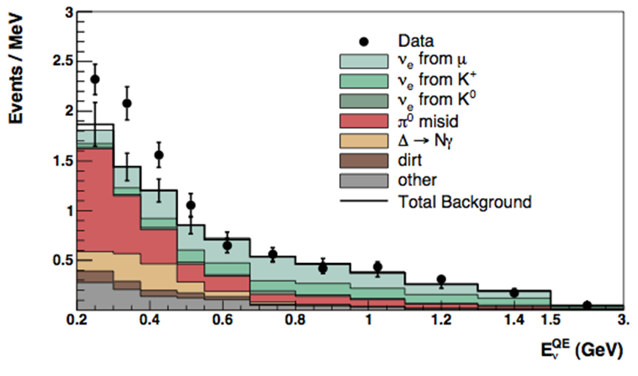
our final result with the neutrino beam

