Slide 1
Silicon Track labs
Day 1 introduction
G. Bolla
bolla@cern.ch

Slide 2
Silicon Track labs
Day 1 introduction
Safety:
The instrumentation you will use is as safe as the one you have in your house.
Implications:
Pay attention to what you do.
Ask for help if you have any question mark.
Radioactive sources handling has been covered somewhere else.
Common sense should cover all needs.

Slide 3
Silicon Track labs
Day 1 introduction
What is a silicon detector?

Slide 4
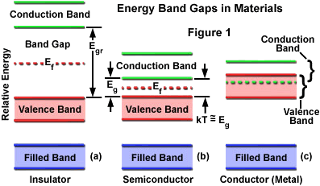
Silicon Track labs
Day 1 introduction
Why a semiconductor?

Slide 5
Silicon Track labs
Day 1 introduction
Reverse biased p-n junction

Slide 6
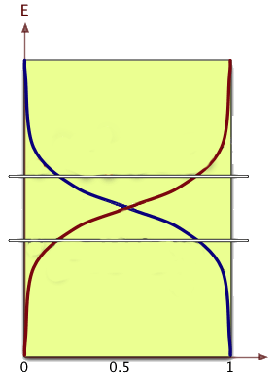
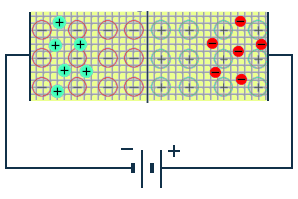
Silicon Track labs
Day 1 introduction
Ionization in the depleted region
γ
No free carriers in the depletion region!
hν > 1.12 eV (photon),
Promoted electron
+
γ
_
E
The E field prevents pair recombination
+
_
E
Current

Slide 7
Silicon Track labs
Day 1 introduction
Ideal Charge sensitive amplifier
Output voltage proportional to input charge (current)

Slide 8
Silicon Track labs
Day 1 introduction
Typical signal size
Ionization energy is 3.6eV
m.i.p. release ~300 eV/μm in Silicon.
Typical thickness of silicon ranges from several to 300 μm.
Typical signal size is in the range of 1-20 Ke-.
Signal is available at the electrode in time scale of nsec.
The thicker the silicon the longer the charge collection time

Slide 9
Silicon Track labs
Day 1 introduction
Noise: 3 main components

Slide 10
Silicon Track labs
Day 1 introduction
Detector design and operation try to maximize the signal/noise ratio.
Signal is constant
Proportional to the thickness
Small dependence on the particle (energy and mass).
Noise depends on several variables
Leakage current
Thermally generated carriers that contribute with a continuous current through the electrodes.
Channel capacitance
Depends on design and on Si-SiO2 interface
Both this contributions can strongly depend on radiation damage.

Slide 11
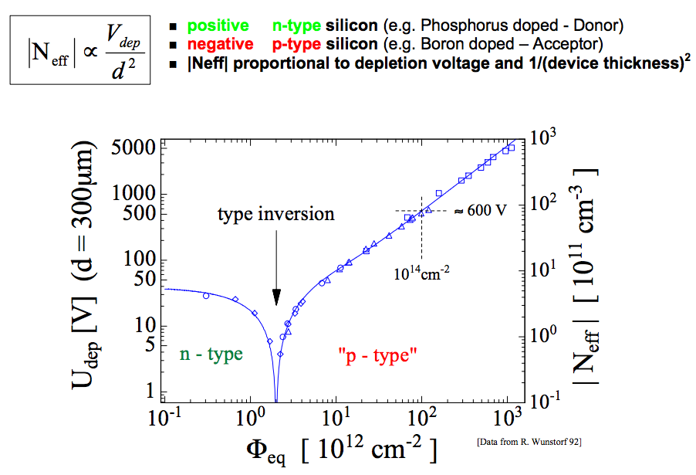
Silicon Track labs
Day 1 introduction
Rad damage: changes in depletion voltage

Slide 12
Silicon Track labs
Day 1 introduction
Rad damage: changes in leakage current

Slide 13
Silicon Track labs
Day 1 introduction
Radiation Damage implications:
Leakage current increase → More noise (Performance degradation)
Depletion voltage increase → more power dissipated.
The only way to counter-balance (and keep the performance) such effect is to lower the temperature of the silicon itself.
This imply more cooling capacityin the tracking region.
Cooling capacity implies more material → more multiple scattering
More multiple scattering → less resolution on the tracks (again Performance degradation).
It looks like a dog trying to byte its own tail.
The way out is a good compromise at the design level of the various components.

Slide 14
Silicon Track labs
Day 1 introduction
Example: CMS pixel.
Material budget is completely dominated by services (cooling, cables, mechanical support).
Picture: material budget for the pixel barrel detector only in terms of radiation lengths x/X₀ as a function of pseudo-rapidity, showing the various
categories of material.

Slide 15
Silicon Track labs
Day 1 introduction
What are you going to do today:
Leakage current measurements
Overall quality of the silicon detector under test
Capacitance-Voltage measurements Depletion voltage of the detector under test.

Slide 16
Silicon Track labs
Day 1 introduction

Slide 17
Silicon Track labs
Day 1 introduction

Slide 18
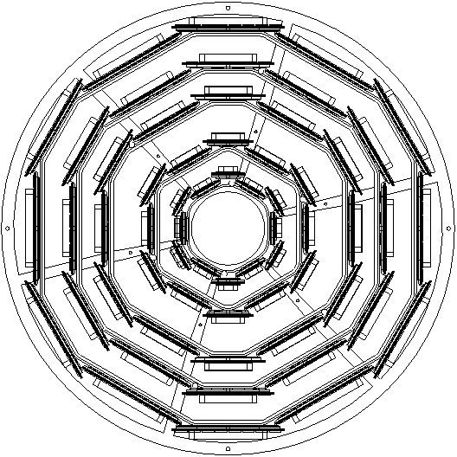
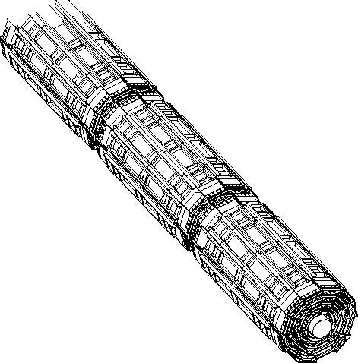
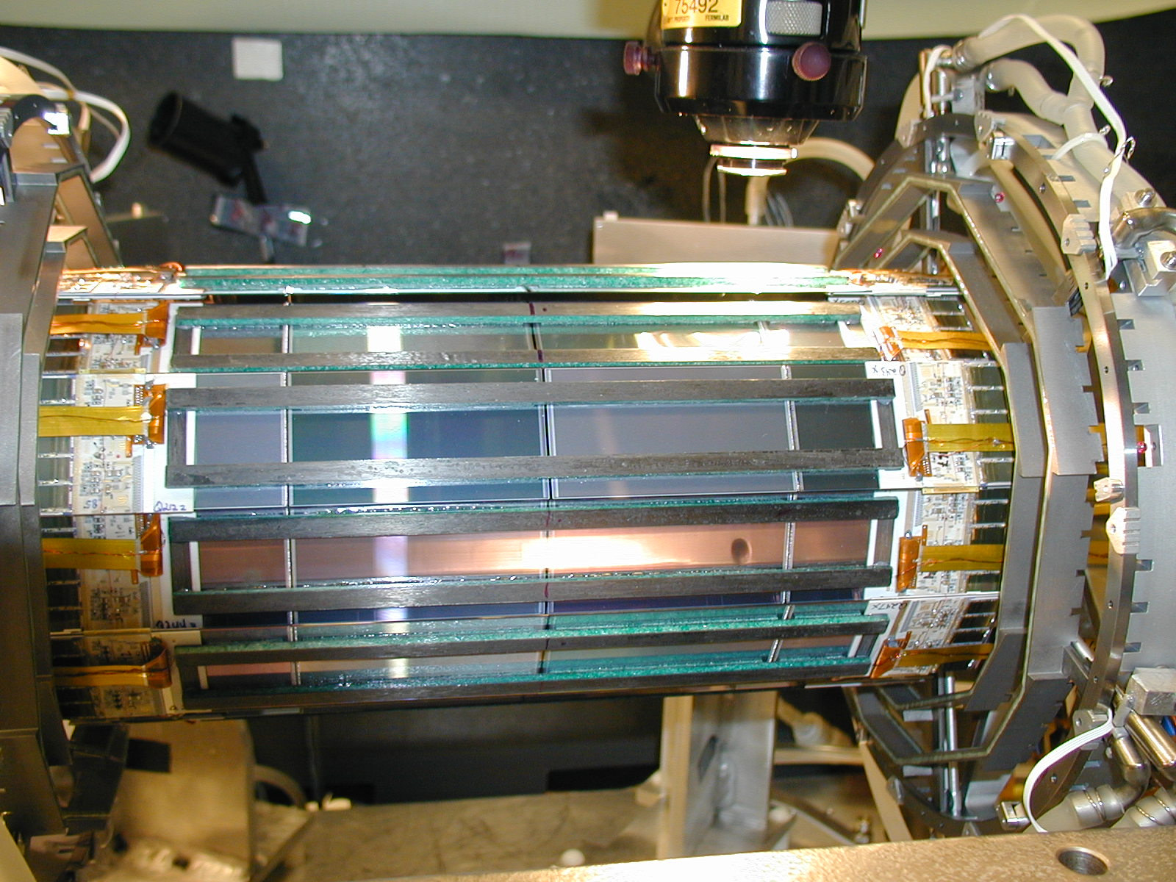
Silicon Track labs
Day 1 introduction
10.6 cm
6 electrical barrels
2.5 cm
Z
5 double sided layers
3 x 90º and 2 x 1.2º
Very compact
Tight alignment tolerances
For the trigger
Very symmetric
Many (maybe too many) different components
x
y
Note “wedge” symmetry

Slide 19
Silicon Track labs
Day 1 introduction
The largest silicon detector: The CMS tracker.

Slide 20
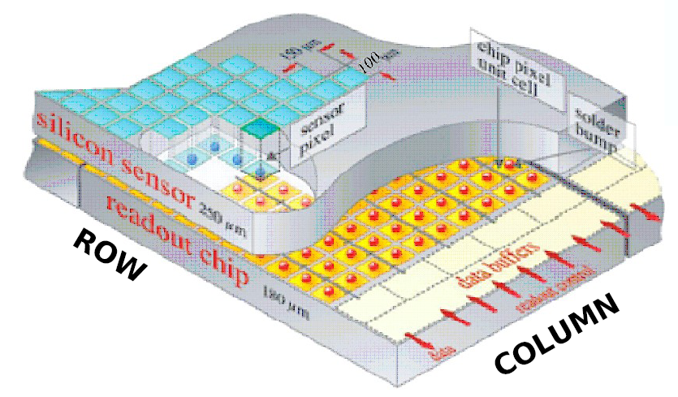
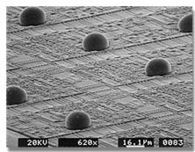
Silicon Track labs
Day 1 introduction
The CMS pixel
No longer possible to use small wire for the interconnection (Density too high)
Hybrid detector use “bumps” to connect the particle sensitive pixel array to the readout chip with the array of amplifiers.
ReadOut Chip (ROC) bump bonded sensor pixels.
52 × 80 = 4160 pixels per ROC
15,840 ROCs
66 million pixels
zero-suppressed output
Each ROC can be tuned (DAC)
Each pixel has a programmable threshold (adjusting this is called trimming)

Slide 21
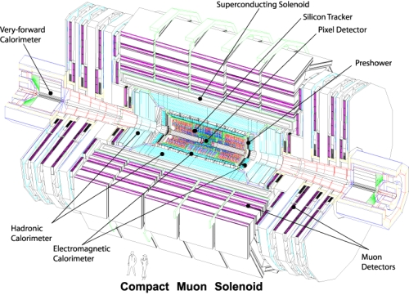
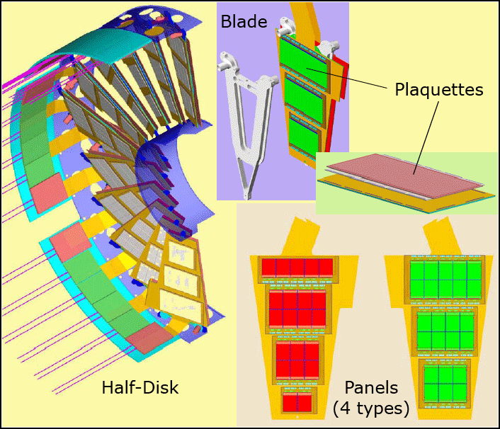
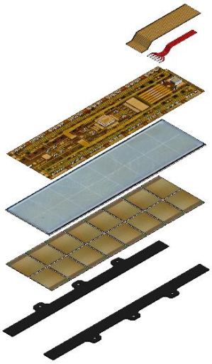
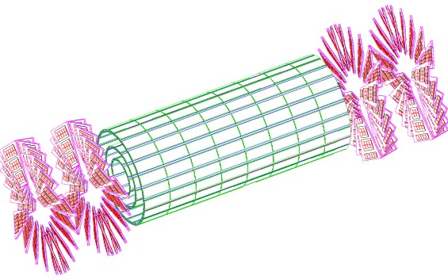
Silicon Track labs
Day 1 introduction
Panels of the Forward Pixel Detector
Forward Pixel Detector (FPix) has two disks on each side at 34.5 cm and 46.5 cm
FPix has 672 modules
Barrel Pixel Detector (BPix) has 3 layers of radii 4.3 cm, 7.2 cm and 11.0 cm
BPix has 768 modules
Total of ~15,840 Readout Chips
The CMS Pixel Detector
53 cm
93 cm
65 mm
2/22/12
Modules of the Barrel Pixel Detector
21

Slide 22
Silicon Track labs
Day 1 introduction
What are you going to do today:
You will follow the steps to build silicon detector modules.
You will performa metrology measurements on already asssembled modules (quality control)
You will follow the steps of establishing the interconnection between sensors and readout chips for a microstrip detector (wirebonding).
And if there is time left…

Slide 23
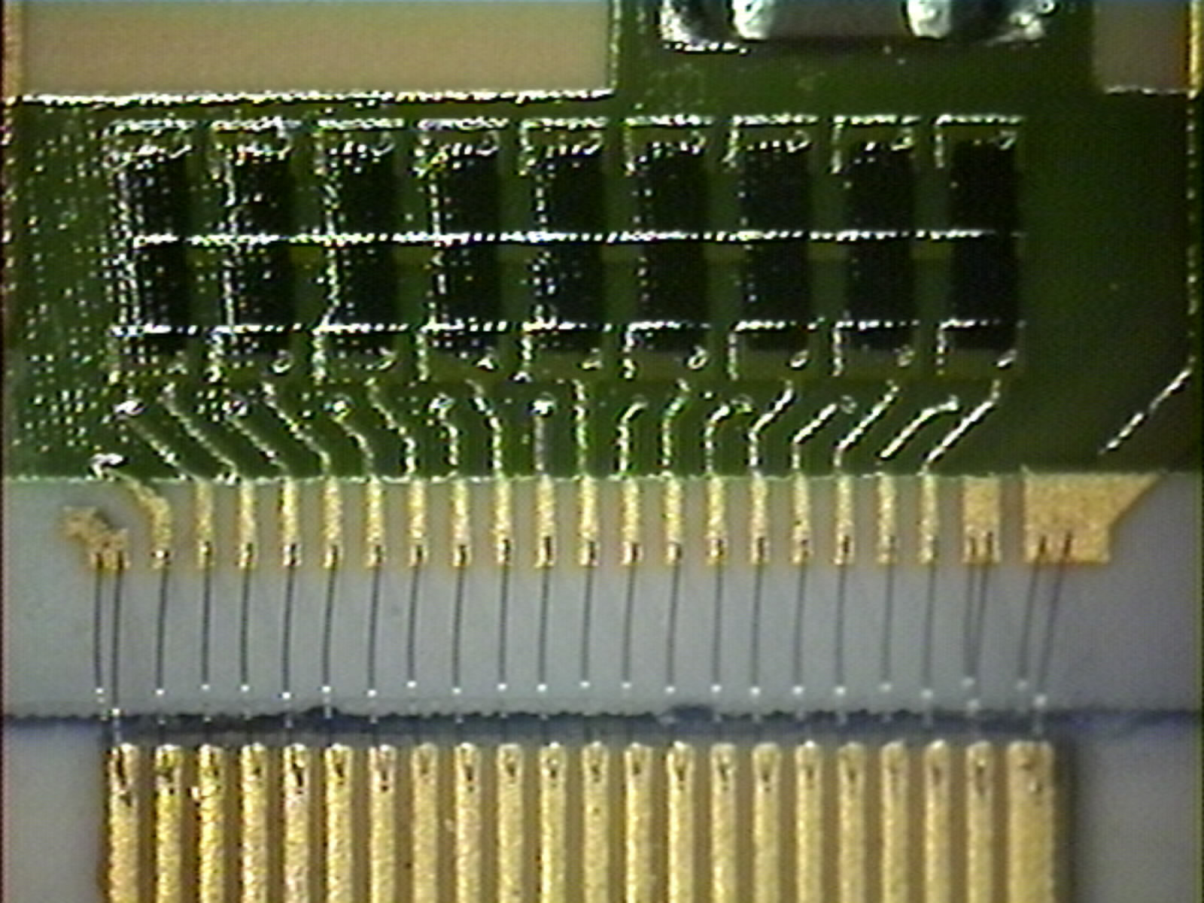
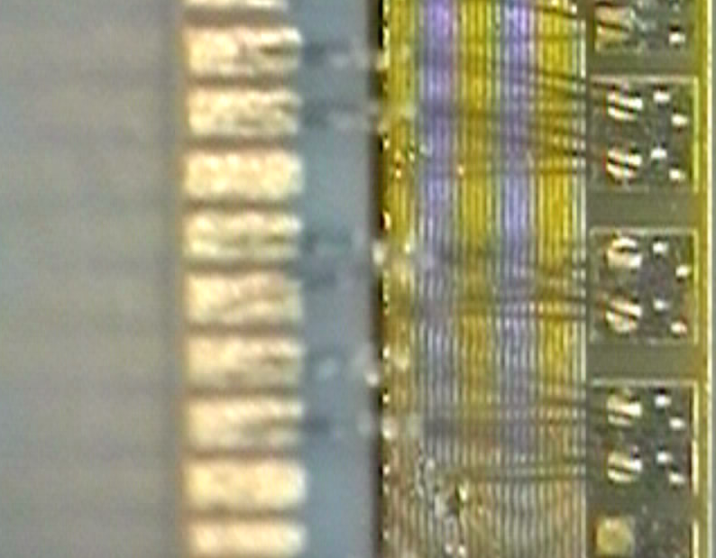
Silicon Track labs
Day 1 introduction
With a 1.4 T Magnetic Field, 200 mA of current and a 2 millimeter bond in a plane that is orthogonal to the field the forces are in the range of 5E-4 N (50 mg).
The induced movement should not exceed 3-4 μm (hard to measure on a 25 μm Al wire)
Resonant behavior is expected and the natural resonant frequencies are in the KHZ range depending on the length and shape of the wires (CDF is interested only up to 50 KHz)
DOIM Bonds step up from
the CPC to the substrate
Oscillating
Current
Lorentz
Forces
Jumper Bonds
Magnetic field.

Slide 24
Silicon Track labs
Day 1 introduction

Slide 25
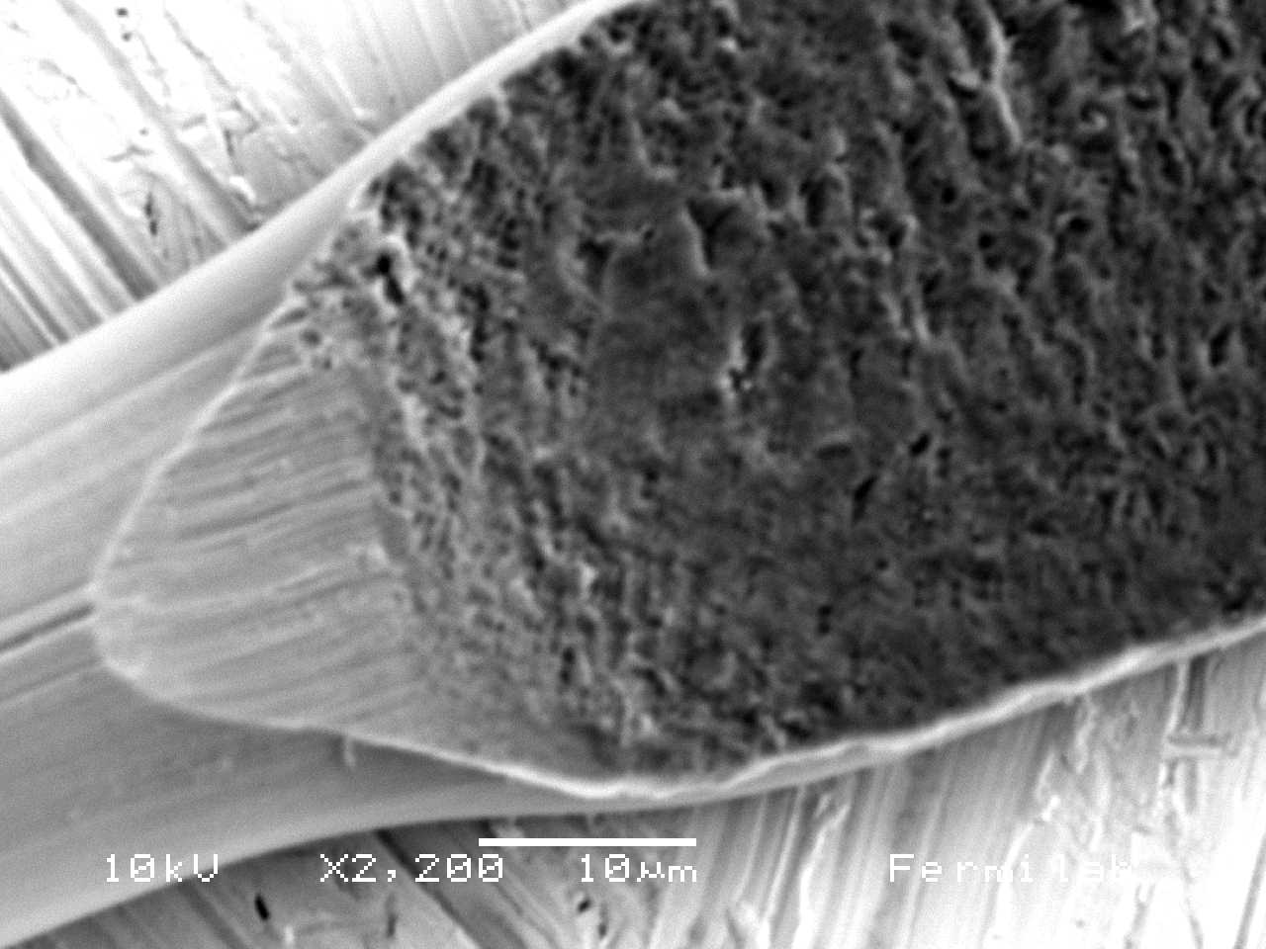
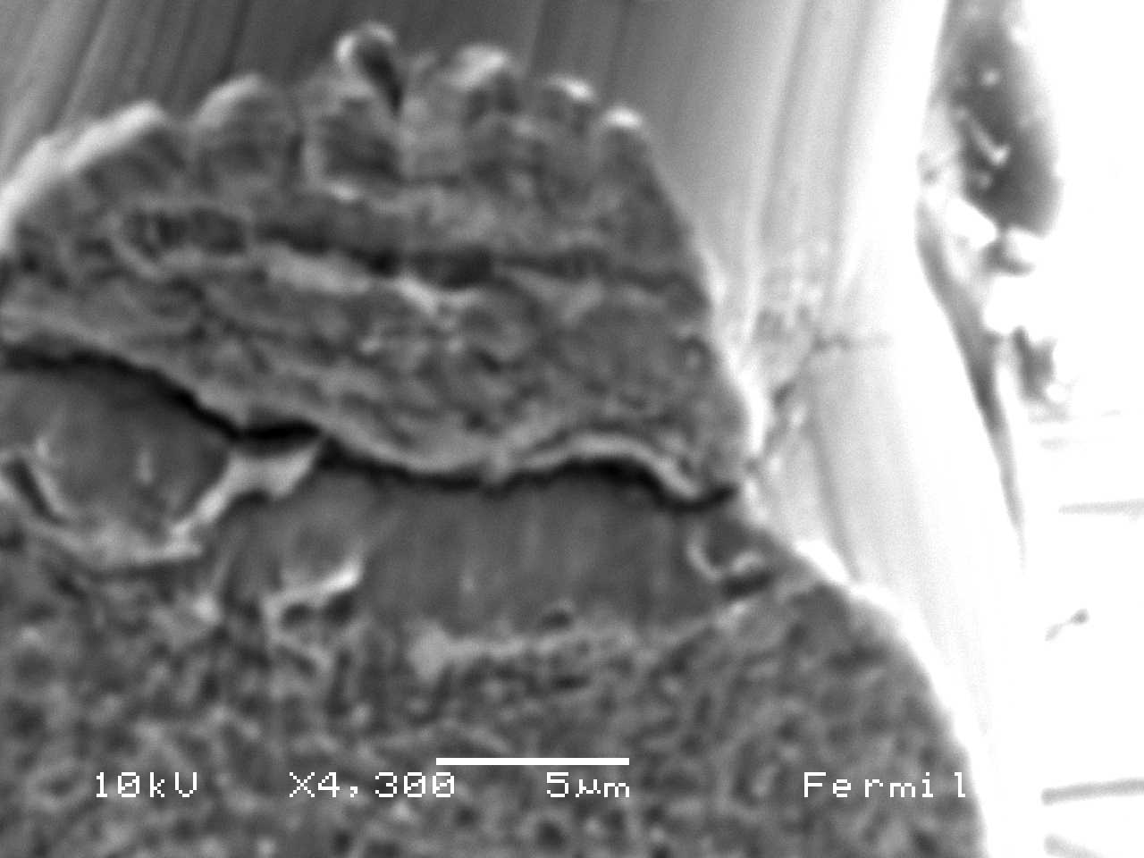
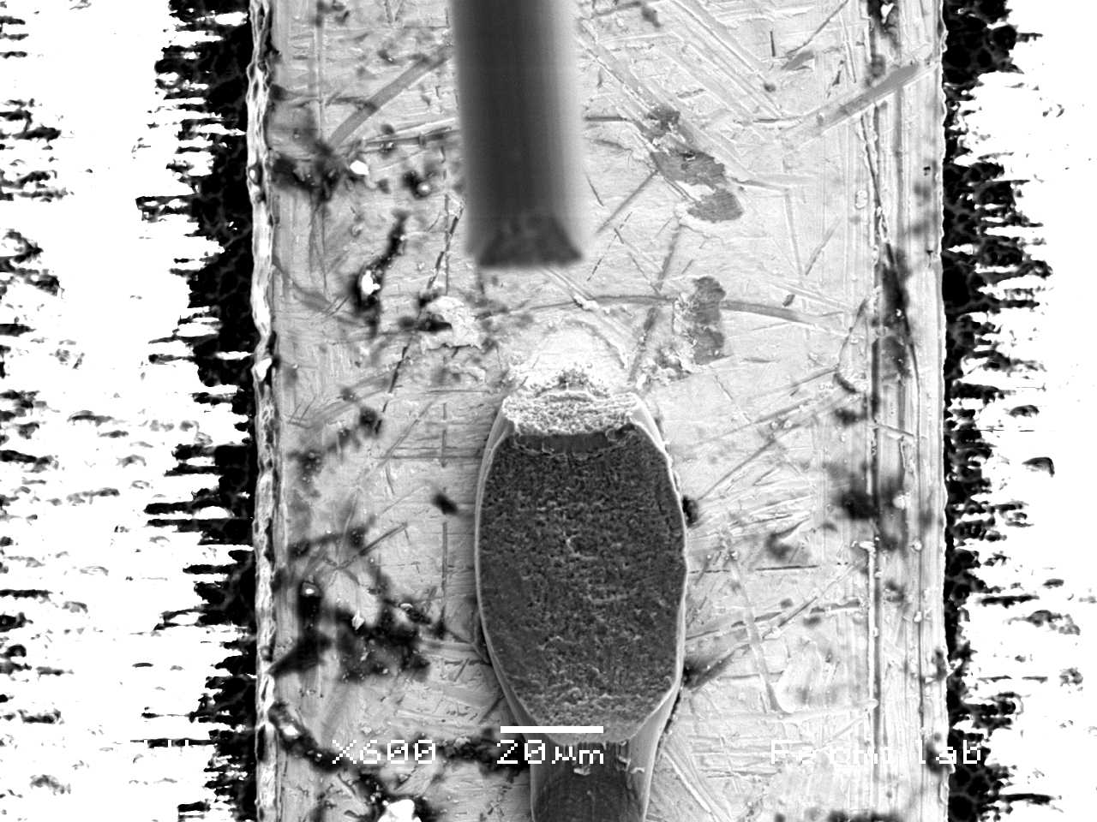
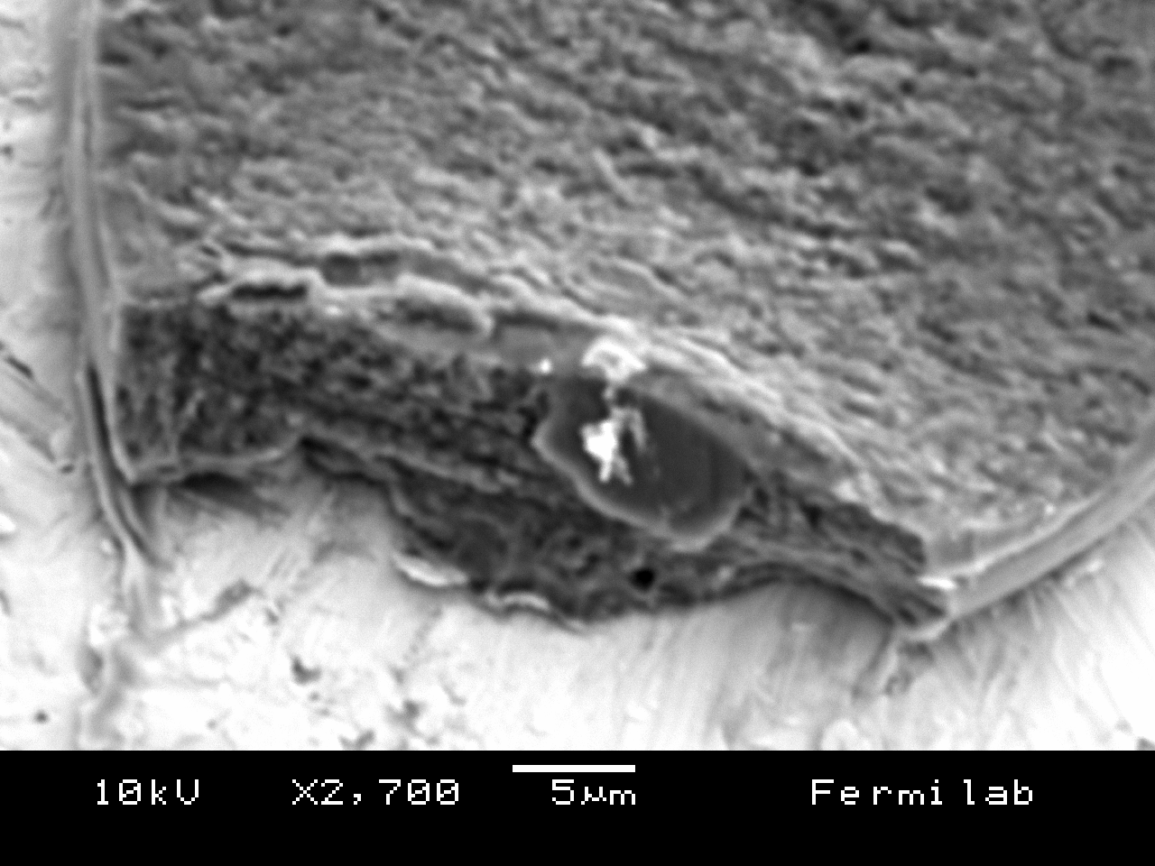
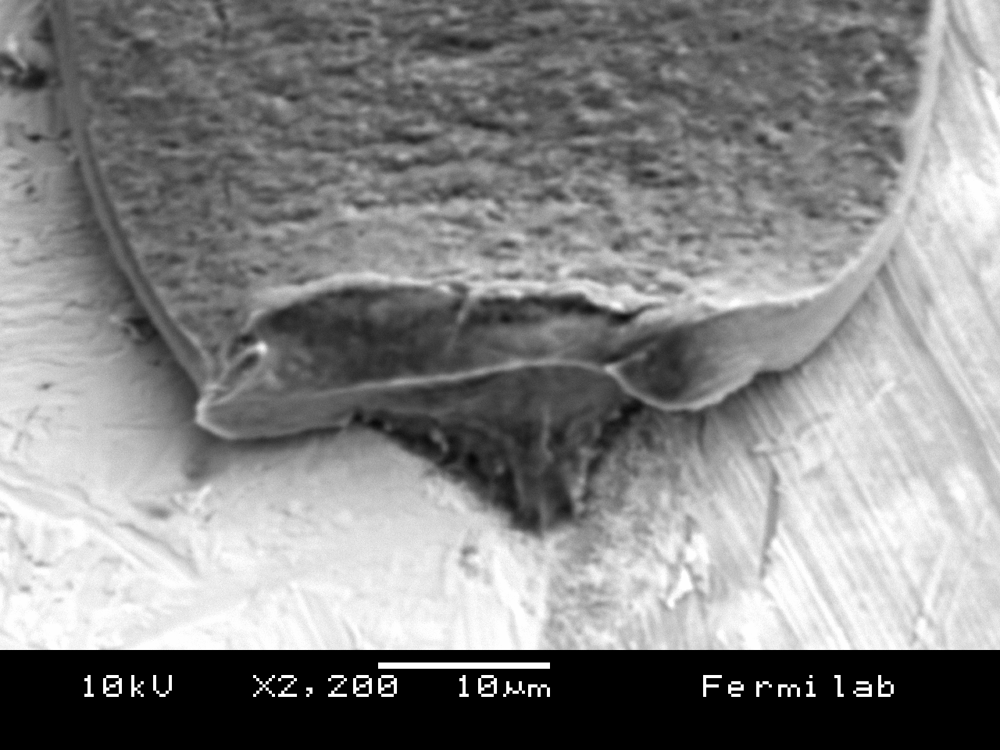
Silicon Track labs
Day 1 introduction
Wire-bonds break due to fatigue stress on their heel induced by resonant vibration. These resonant vibrations are a direct consequence of the oscillating Lorentz forces induced by the magnetic field on wire-bonds with non-DC current.
Resonated bond
Pulled bond

Slide 26
Silicon Track labs
Day 1 introduction
Selcuk will work with you at the probe stations
Greg will help you out with mechanics, metrology and interconnections.
I should be able to join this part as well.
Greg Derylo
Fermi National Accelerator Lab, USA
Phone: 630.840.6104
Email: derylo@jabber.fnal.gov
Greg is a Fermilab mechanical engineer where he has worked on the design and fabrication of various silicon-based detectors since 1997, including silicon strip detectors for CDF & DZero and the forward pixel detectors for CMS. He also developed the CCD packages and built the 0.57 Gpixel imager for the Dark Energy Survey Camera. Greg is currently working on the Jefferson Lab Clas12 SVT.

Slide 27
Silicon Track labs
Day 1 introduction
SPARE SLIDE

Slide 28
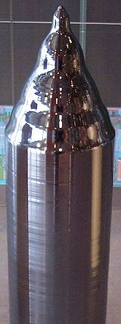
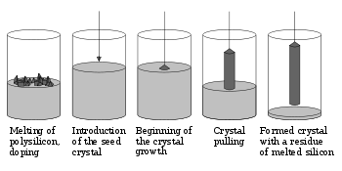
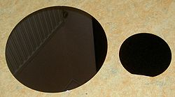
Silicon Track labs
Day 1 introduction
SILICON device fabrication:

Slide 29
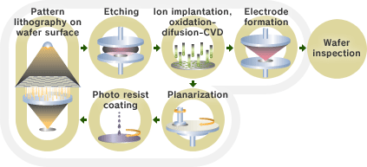
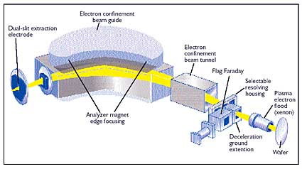
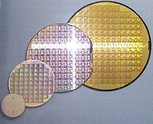
Silicon Track labs
Day 1 introduction
SILICON device fabrication:

Slide 30
Silicon Track labs
Day 1 introduction
Selcuk will work with you at the probe stations
Kirk will help you out with mechanics, metrology and interconnections.
I should be able to join this part as well.

