Slide 1
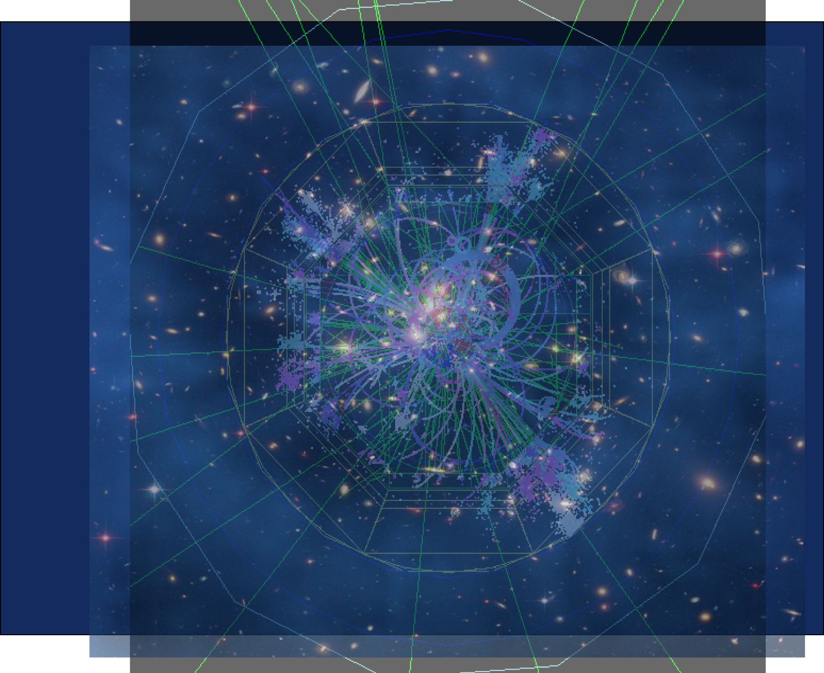



Silicon Sensors for Collider Physics
from Physics Requirements to
Vertex Tracking Detectors
Marco Battaglia
Lawrence Berkeley National Laboratory,
University of California at Santa Cruz
and CERN, Geneva
EDIT 2012, Silicon Track, February 2012

Slide 2
Vertex Detectors and Extrapolation Resolution

Slide 3
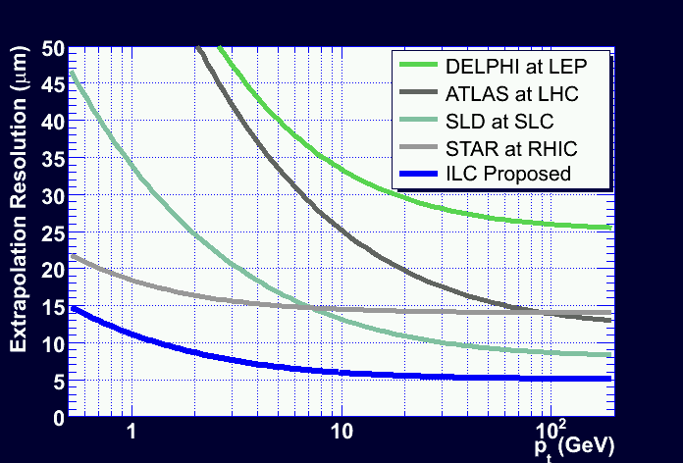
Distance from point of closest
approach to primary vertex does
not scale with energy
i.p. = βγcτ cos α
cos α ~ 1/γ
α
PVtx
l = βγcτ
SecVtx
i.p.
B from H decay at 0.5 TeV
m_{B} = 5.2 GeV, cτ = 480 μm
E_{B} = 0.7 x E_{jet} =
0.7 x 500/4 = 100 GeV
∼ 70
<l> ~ 3.5 mm
 | b | c | g
<l> (mm) | 3.5 | 1.3 | ~ 0.
cτ (μm) | 480 | 217 | ~0.
<N_{sec}> | 5.1 | 2.7 | ~ 0.

Slide 4
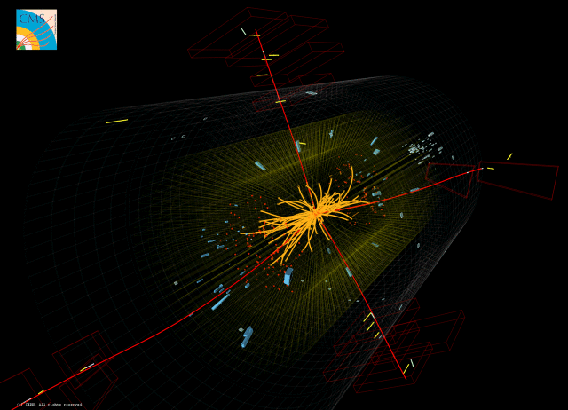
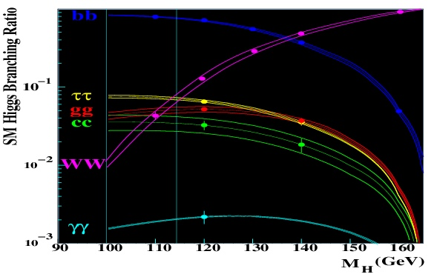
Higgs Couplings

Slide 5
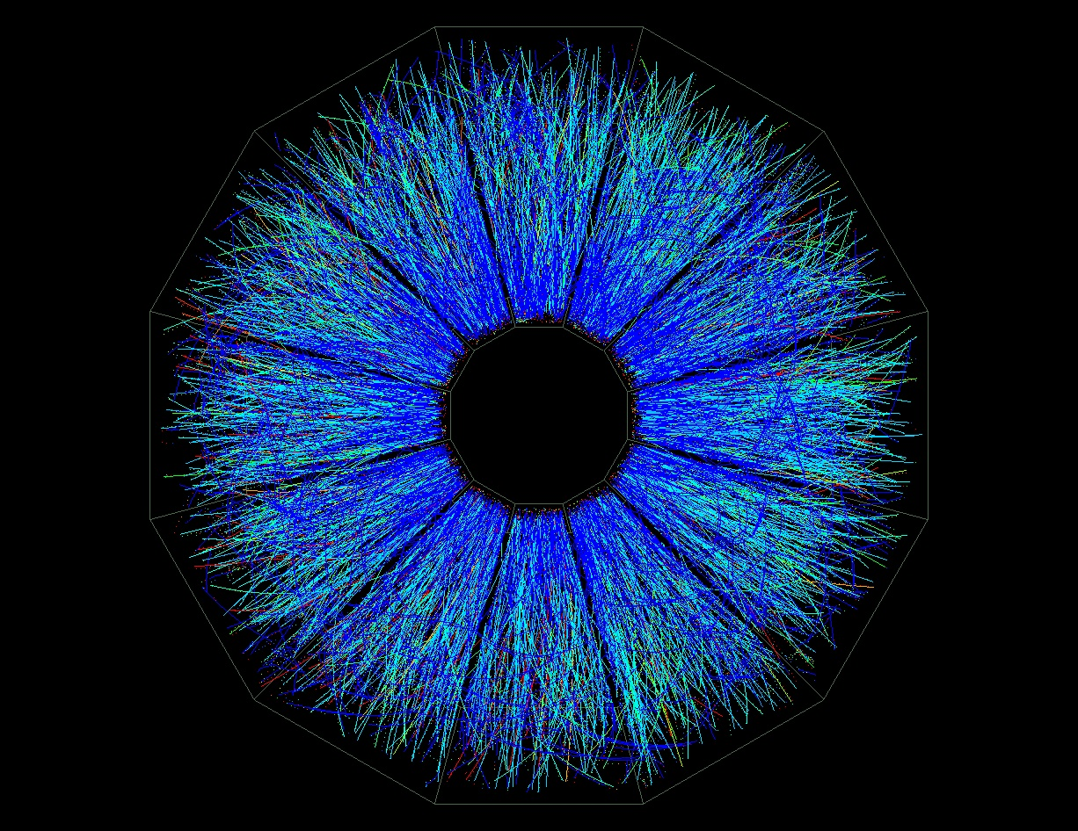
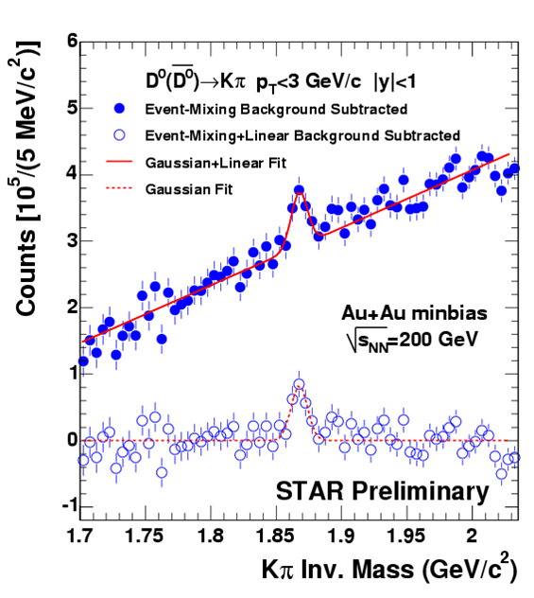
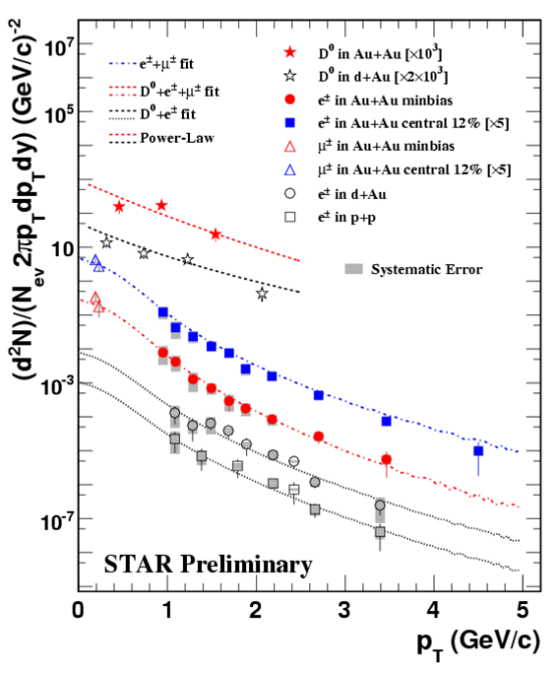
Vertexing in
Heavy Ion Collisions
(SGV Fast Simulation)

Slide 6
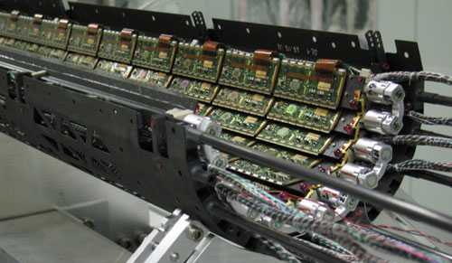
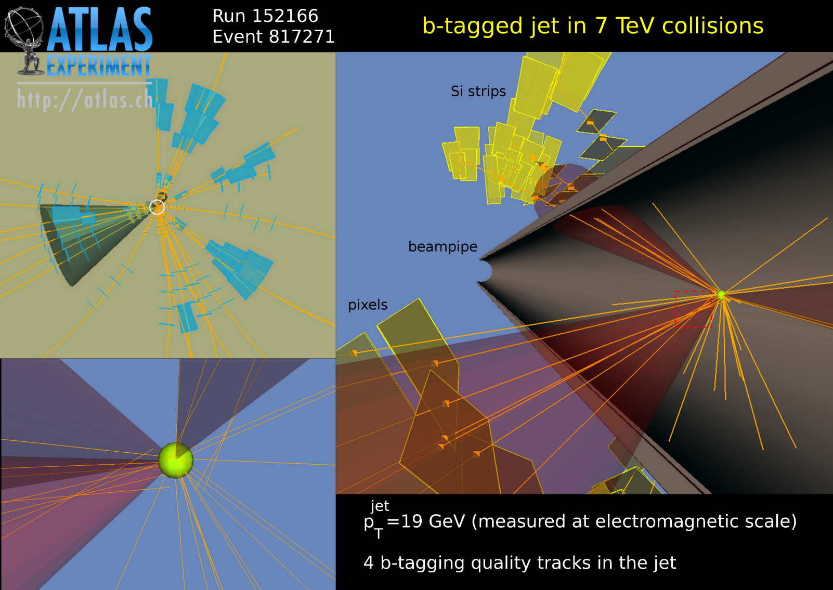
Tracking and Vertexing at LHC
ATLAS at LHC at CERN
(2008-)
pp 7-14 TeV
Hybrid Pixels
1.4 m²
80 M Pixels

Slide 7
Interaction of Charged Particles in Si

Slide 8
Interaction of Charged Particles in Si

Slide 9
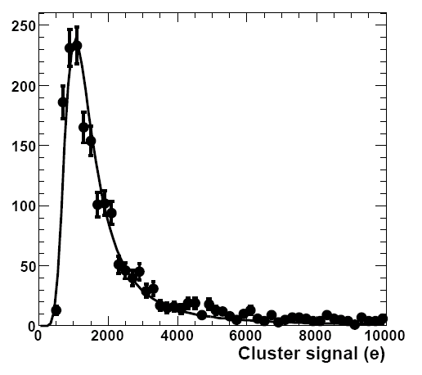
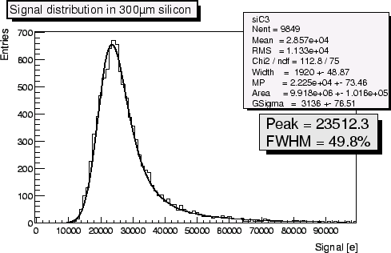
Interaction of Charged Particles in Si
120 GeV protons
14 μm Si
280 eV / μm (m.p.)
3.6 eV per e-h pair
→ ~80 e- / μm
300 μm Si

Slide 10
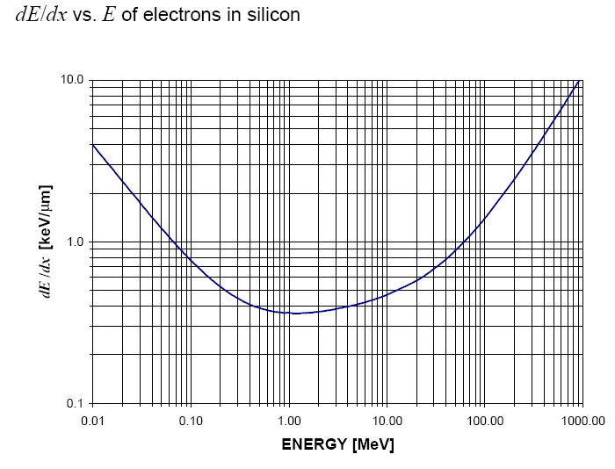
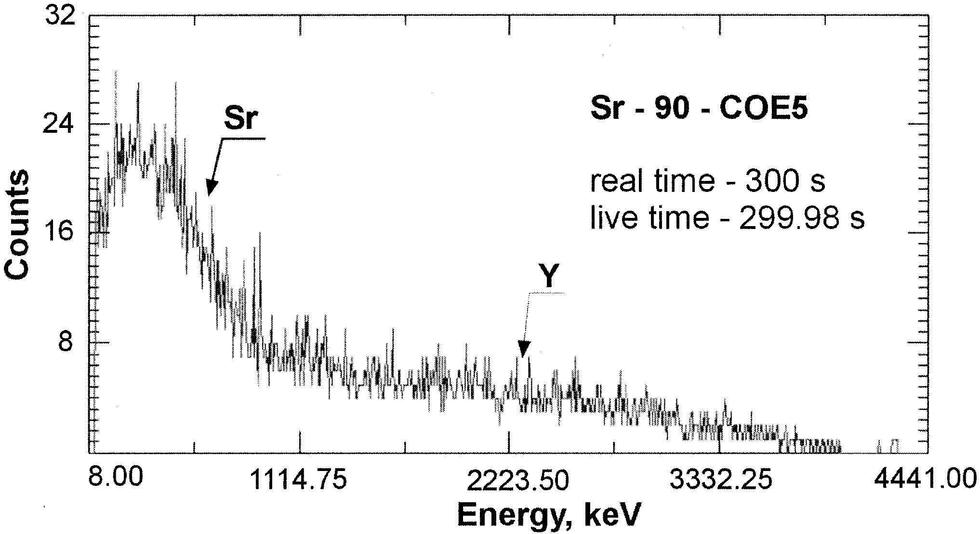
Interaction of Charged Particles in Si
Electrons
⁹⁰Sr source electron spectrum

Slide 11
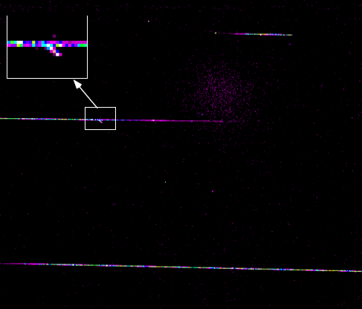
Energy Deposit in Si

Slide 12
Energy Deposit in Si

Slide 13
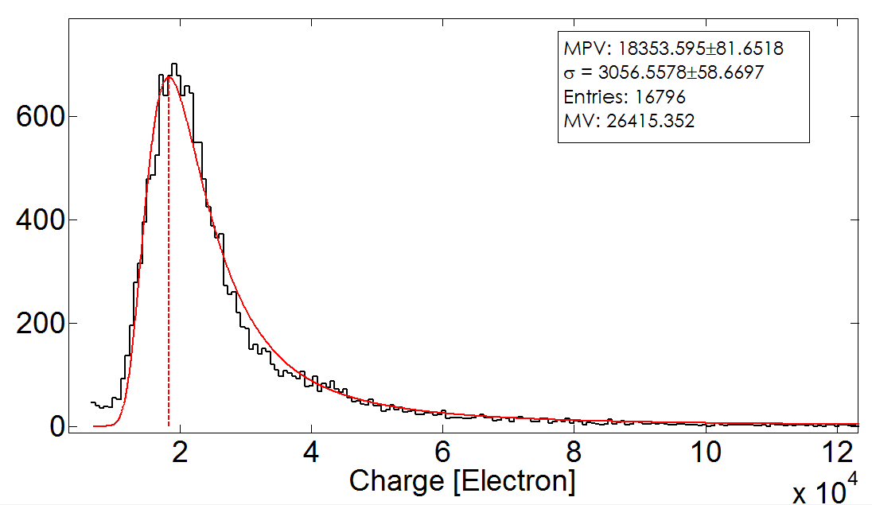
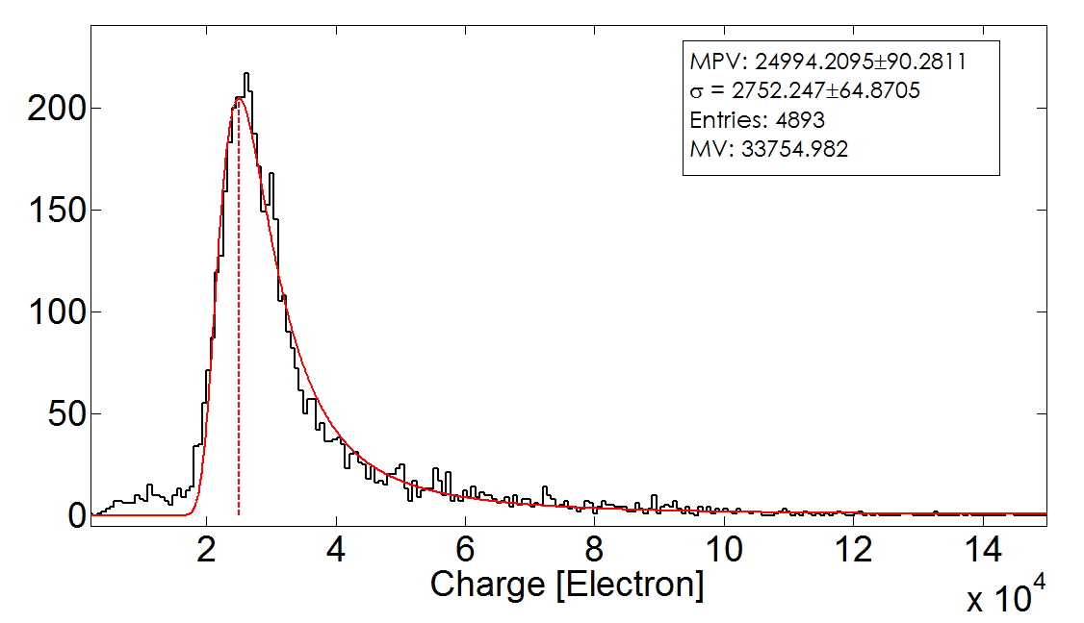
Energy Deposit in Si
CMS Pixels
beam test results with
500 MeV electrons
Vd = -50 V
m.p. charge value = 18000 e-
Vd = -150 V (fully depleted)
m.p. charge value = 25000 e-

Slide 14
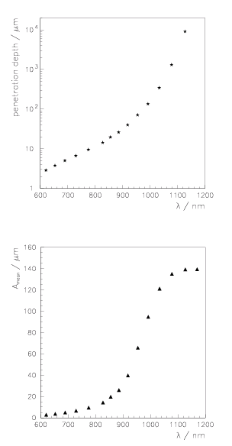
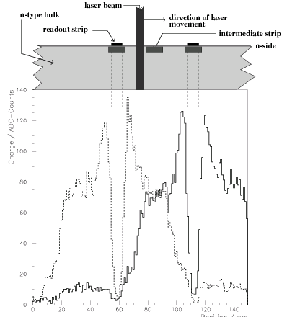
Simulating m.i.p. with IR Laser
Abtet al.,
NIM 423 (1999)

Slide 15
Position Sensitive Detectors

Slide 16
Microstrip Detectors (1D segmentation)

Slide 17
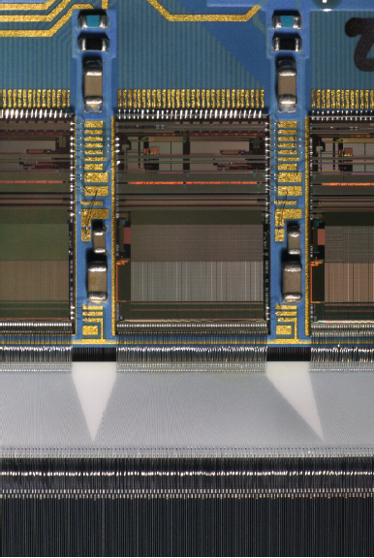
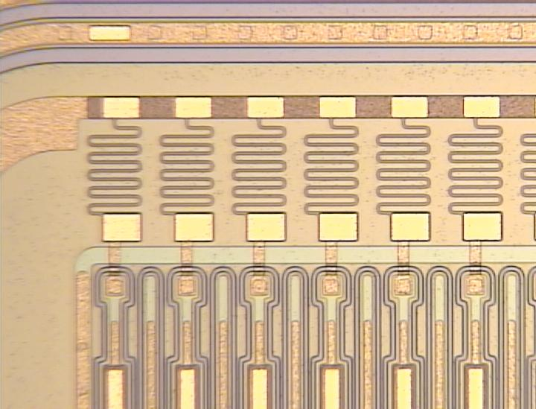
Microstrip Detectors
25 μm pitch microstrip with S/N=75 g σ_{point} = 1.3 μm
Straver et al.,
NIM 348 (1994)

Slide 18
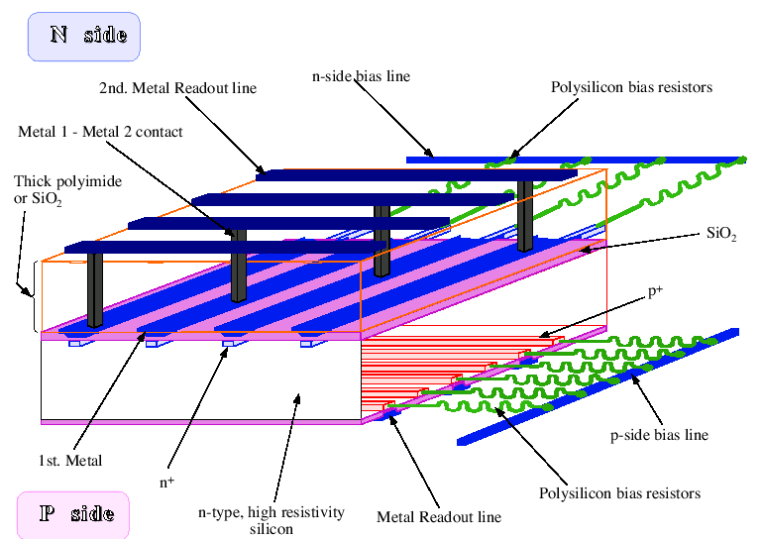
Double-sided Strip Detectors (1+1D segmentation)

Slide 19
From Strips (1D) to Pixel (2D) Detectors
2x 1D information
generates ambiguities:
n hits g n² combinations
of which n²-n are ghosts
Example:
Pattern recognition of
2 particle tracks on
double-sided microstrips
Need real 2D info:
from strip to pixel

Slide 20
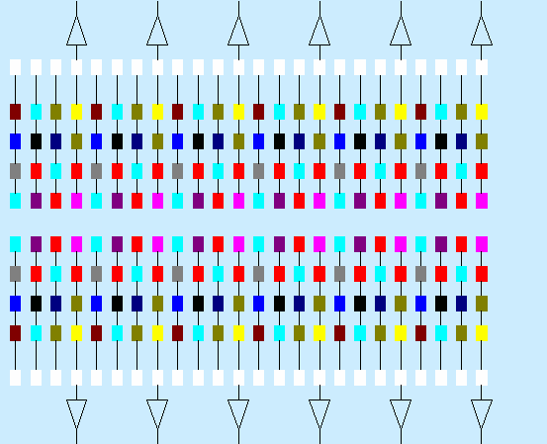
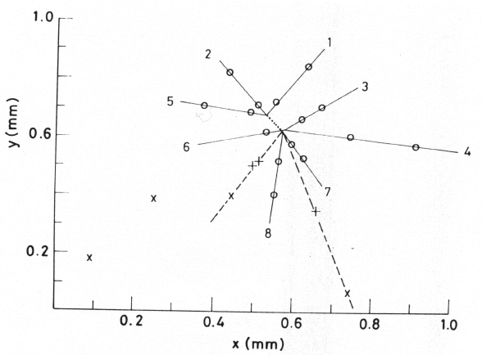
2D Sensor + 1D Readout
Main limitation due to interconnect;
How to bring charge from detector
node to readout node ?
Concerns are length of connections
(capacity), technical feasibility
of high channel density;
Early solution: shift charge from detector node to detector chip periphery:
g Charge Coupled Devices (CCDs)
NA32 Fixed Target
Experiment at
CERN SPS
(1984-1986)
200 GeV π beam on Be
2 layers of CCDs
Observation of
Λ_{c} baryon decay

Slide 21
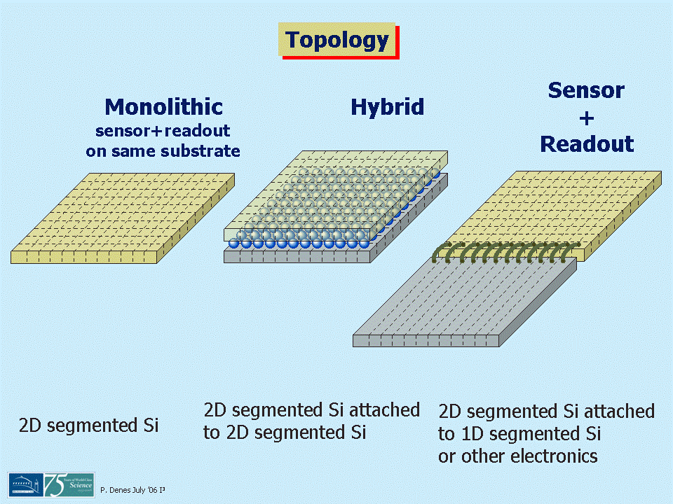
Sensor
Topology
First Hybrid Pixel Detector for HEP
WA97 Fixed Target
Experiment at
CERN SPS
(1995-1996)
Pb beam on Pb target
Hybrid Pixel Telescope

Slide 22
2D Sensor + 2D Readout: Hybrid Pixels
Pioneered in DELPHI at LEP
and extensively used at LHC;
Great progress in bump bonding
pitch and yields;
Spinoff to imaging (MediPix)
Advantages include:
sophisticated signal processing on-pixel
(TOT, trigger, sparsification, calibration, autocorrelation);
decouple process for sensor and readout electronics;
Main Limitations are:
large(r) material budget, pixel cell size limited by electronics cell
and interconnect (bump bonding) pitch (~40 μm).

Slide 23
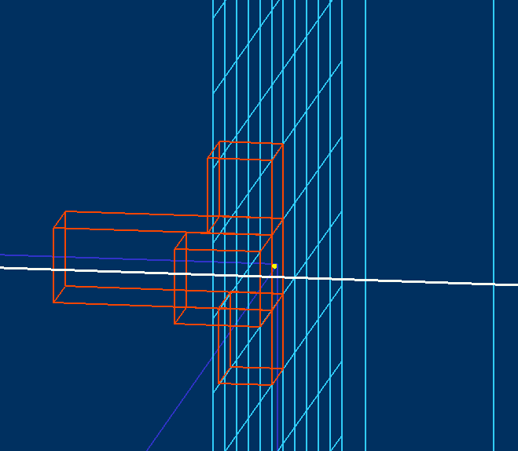
Pitch Size, Occupancy, Resolution
Binary Readout:
Charge Interpolation:
LBNL Pixel
Telescope
1.5 GeV e⁻
Cluster
Reco Hit
extrapolated
track
V=100 V, d = 300 μm
σ_{charge} ~ 7 μm
V~0 V, d = 15 μm
σ_{charge} ~ 15 μm

Slide 24
Pitch and Charge Sampling
CERN WA-92 decay detector:
Microstrip detector with
10 μm pitch and individual
strip readout;
Charge centre of gravity
reconstruction;
Space resolution depends also
on detector thickness:
300μm thick detector has more
charge spread for diffusion
(2 strip clusters) and thus better
sampling compared to 150μm
(1 strip clusters);
Antinori et al.,
NIM 288 (1990)

Slide 25
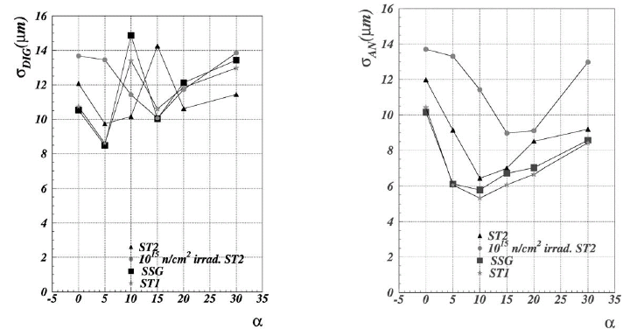
Pitch and Charge Sampling
ATLAS Pixel Tracker: Pixel sensors with 30x382μm² cells
Spatial resolution with digital and analog readout for various
track incidence angles α:
Gorelov et al.,
NIM 481 (2002)

Slide 26
Pitch and Charge Sampling
σ_{point} vs. pixel pitch
CMOS pixel sensors
active thickness ~15μm, S/N ~ 20
σ_{point} vs. S/N
CMOS pixel sensors
active thick. ~15μm, pitch 40 μm
Winter et al.,
ALCPG 2007
MB et al.,
ALCPG 2007

Slide 27
Charge Interpolation
Reduce number of readout channels by using floating intermediate
charge collecting nodes (strips or pixels) capacitively coupled to
readout nodes;
Need to keep
C_{ss} > C_{SG}
to minimise
charge loss to
backplane (gnd)

Slide 28
Charge Interpolation with Floating Nodes
Test Sensor with interleaved pixels,
100 μm pixel, 200 μm readout pitch:
C_{ip} ~ 900 fF
C_{bp} ~ 400 fF
6 μm
point
resolution
MB et al.,
IEEE TNS 48 (2001)

Slide 29
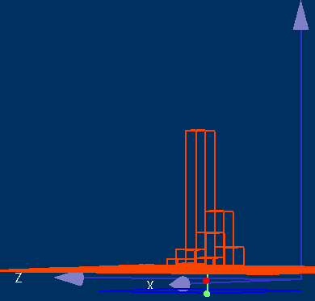
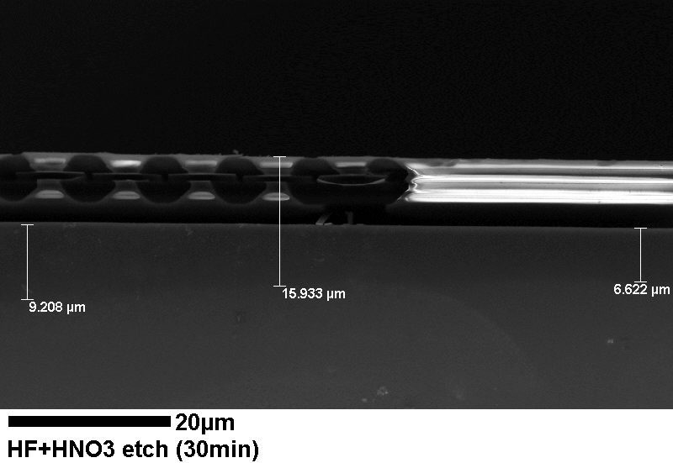
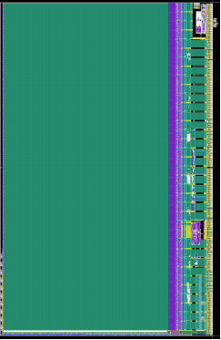
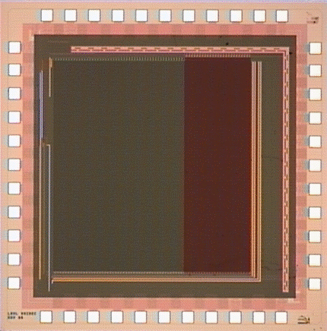
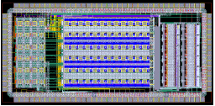
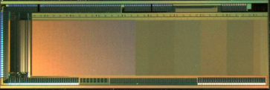
2D Sensor & 2D Readout: Monolithic Pixels
Embed both detector
sensitive volume and
(part of) readout
Electronics in same
Si wafer;
Advantages:
Thin devices,
no interconnect,
minimal capacitance;
Challenges:
avoid parasitic charge collection;
ensure high fill factor.
SiO+
Metal
Epi
Si
SEM Image of
LDRD-1 Pixel Chip
Bulk
Si

Slide 30
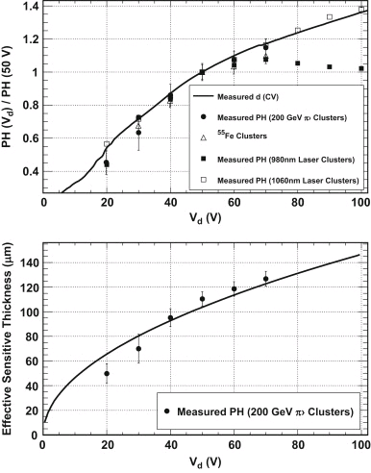
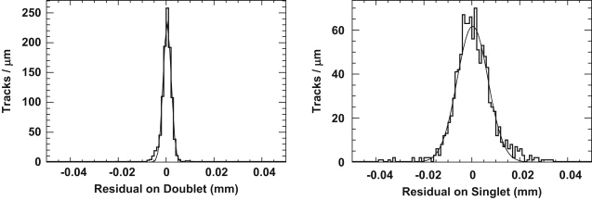
2D Sensor & 2D Readout: Monolithic Pixels
CMOS Pixel sensors on high resistivity
substrate approach charge collection
of hybrid pixels with integrated data
processing capabilities in a single thin
Si layer:
Example Silicon-On-Insulator Pixels
1 μm resolution
with 15 μm pixels
MB et al.,
NIM A 654 (2011)

Slide 31
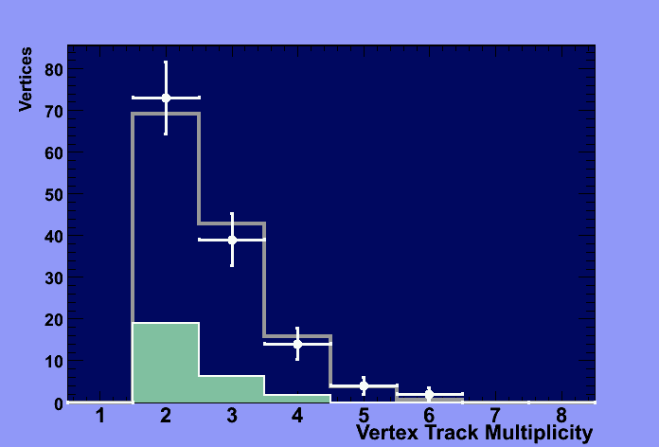
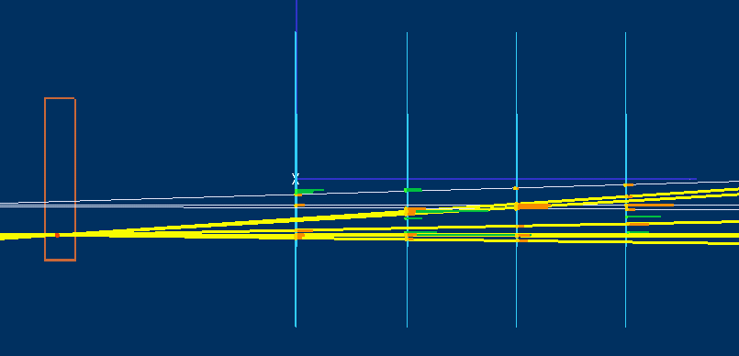
Track Extrapolation and Vertexing resolution
FNAL MBTF T966 Data
120 GeV p on Cu target
LBNL Thin CMOS Pixel Telescope
Τ966 σ_{z} vertex resolution = 230 μm
CLIC σ_{z} vertex resolution in B decays = 210 μm
Extrapolate 3 cm upstream from first Si pixel layer:
MB et al.,
NIM A593 (2008)

Slide 32
Silicon Track Day 2
Microstrip Detectors from D0 and CDF to be tested with small spot IR laser
Microstrip Detector from CMS to be tested with 90Sr
Landau distribution, depletion
Hybrid Pixel Detector from CMS to be tested with 90Sr
DAQ and readout chip, chip calibration, threshold scan,
Landau distribution, scaling of collected charge vs Vd, cluster analysis
CMOS Monolithic Pixel Detector to be tested with 90Sr (and IR laser)
Visualization of analog pixel signal on oscilloscope, driving clocks,
Landau distribution, determination of sensitive thickness, δ ray visalization,
cluster reconstruction and analysis

Slide 33
Tracking and Vertexing
at Colliders
DELPHI at LEP at CERN
(1989-2001)
e⁺e⁻ 89-210 GeV
Microstrip and
Hybrid Pixel Tracker
1 M Pixels
SLC at SLD at SLAC
(1989-2001)
e⁺e⁻ 91.2 GeV
VXD3 CCD Vertex
Detector
307 M Pixels

Slide 34
Tracking and Vertexing at Future Lepton Collider
e⁺e⁻ Linear Collider or MuC
(20XX)
e⁺e⁻ 0.25-5.0 TeV (?)
Monolithic Pixels
~1 B Pixels

