Slide 1
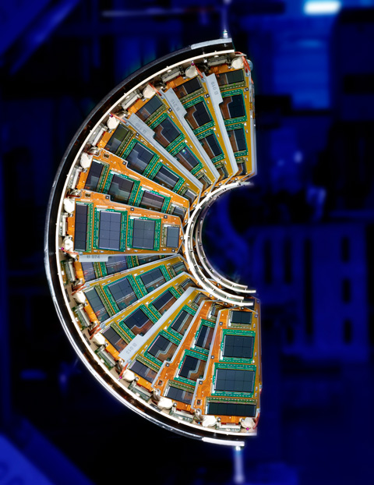
DAQ

Slide 2
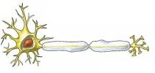
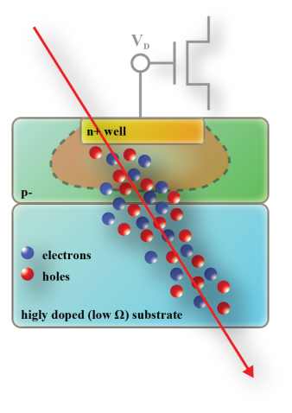
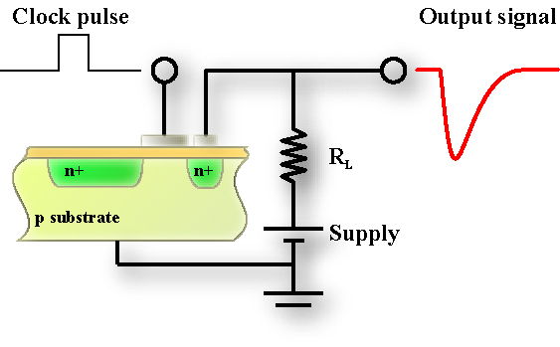
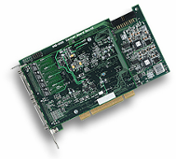
What DAQ is
Sensors usually give us much more information than what we need
Signal
conditioning
Data
Acquisition
Entity to
measure
Data processing
Data storage
Detector
γ
The above example should give an idea of which place a DAQ system takes into an experimental chain. The DAQ system has to codify and transport the information from the sensor to the analysis system. Codification implies both transmission and, if necessary, elaboration (think to eyes neurons!)

Slide 3
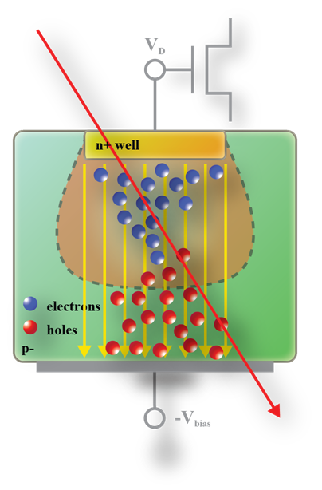
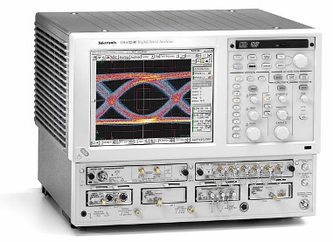
DAQ starting point
A
S
Signal conditioning
We want characterize the response of a detector respect to the incoming ionizing radiation. A common way is to measure the change in time of the charge induced by a single ionizing particle.
In that case, the data acquisition is performed by a fast digital oscilloscope that samples the signal and generates the graph above.

Slide 4
Information - bits
We can define the DAQ as the (sub) system of an experimental setup assigned
to transport the information from the detector to the data analysis/storage system.
As DAQ systems job is to gather and transfer information, it is interesting to get an insight about what information is before proceeding.
= 2¹ = 2 possible messages
1 bit
= 2² = 4 possible messages
DAQ system are mainly based on computers and electronics, and the only basic word computers know is the bit. So, it is handy to think about the information we want to gather from our sensors in terms of bits.
= 2⁸ = 256 possible messages
= 2¹⁶ = 65536 …
Most Significant Bit (MSB)
= 2³² = …
Least Significant Bit (LSB)

Slide 5
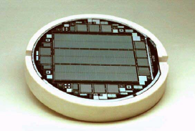
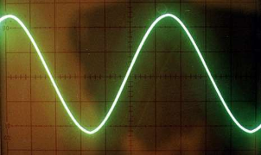
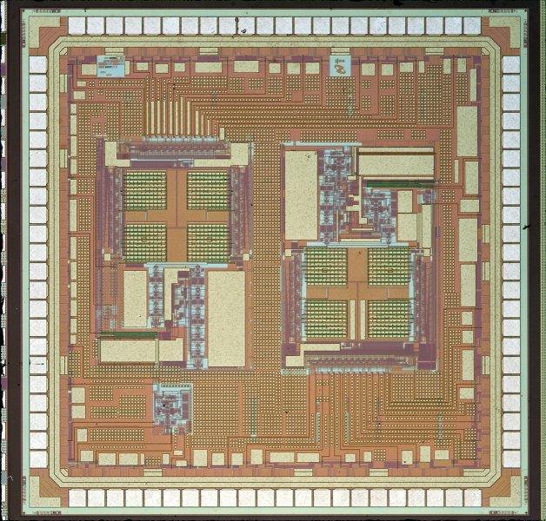
Analog to digital - 1
We usually speak in terms of information and bits, but we know the output of a sensors is not digital at all. A key point in any DAQ system is the conversion from analog to digital signals.
ADC
Binary information
Detector/sensor
Old fashioned analog scope
Two main parameter characterize an ADC:
The resolution, i.e. the segmentation of the measured range, which is usually given in number of bits.
The sampling rate (time resolution), i.e. the maximum working frequency the device is able to sustain.

Slide 6
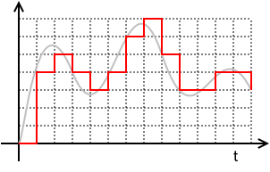

Analog to digital - 2
When we transform an analog signal into a digital one we are losing information. In principle, any analog signal carries a near infinite amount of information.
Analog
V
s(t)
Bandwidth limited
Dynamic range
Resolution, V_{R}
Digital
Sampling rate
Sampling rate limited
If the analog signal has a dynamic range given by V_{MAX}-V_{MIN}, the resolution stated in term of the analog value (V_{R}) will be equal to (V_{MAX}-V_{MIN})/2^{n}, where n is the number of bits of the ADC.

Slide 7
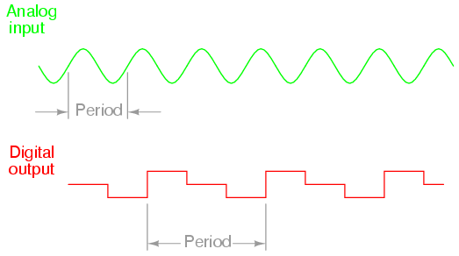
ADC time resolution
First point we need to fix when searching a suitable ADC to sample our signal is to understand which minimum sampling frequency the ADC should offer. The result is stated by the Nyquist sampling theorem.
Analog “ideal” signal
ALIASING
Finite bandwidth signal:
Nyquist theorem

Slide 8
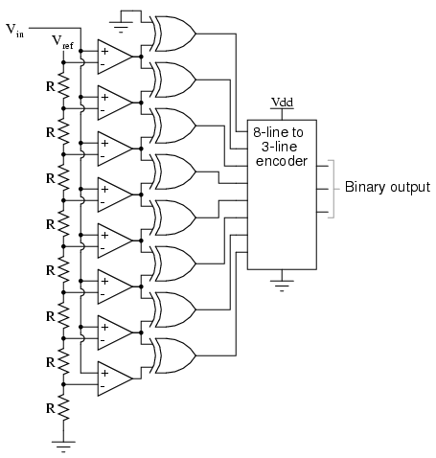
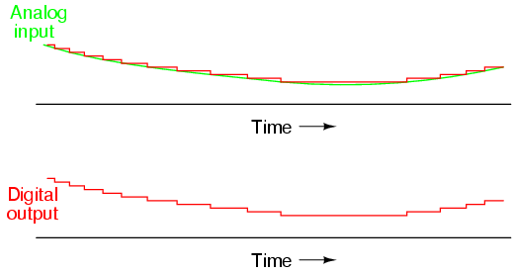
Flash ADC example
Flash ADCs are the fastest available, but their resolution is limited, at present, at 8 (some 9) bits. It is the kind of ADC you find in the (expensive) digital oscilloscopes. They are able to convert Giga samples per second.
10V
V_{R}=1.25
Each cell is a comparator stage where the input is compared to a reference value, giving a 0/1 output.
C
Combinatory logic rearrange the result given by the comparators stage to give a binary value as output.
7V
= 5
V_{D} = 5×V_{R} = 5×1.25 = 6.25
V_{S}
V_{R}
3 bits Flash ADC

Slide 9
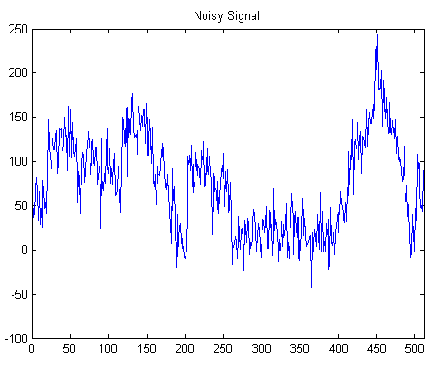
ADC resolution - 1
The ideal matching is reached when all possible information is squeezed out of the input signal. Obviously, down-sampling is possible if full resolution is not needed.
2^{n}
Assuming
1 LSB noise
A_{noise}
A_{signal}
LSB
Dynamic range
It is not useful to have a “segmentation” finer that noise.
Noise requires to be carefully considered, even if it is non random noise!

Slide 10
ADC resolution - 4
Not only the signal level gives restriction to the ADC resolution. Also the way the sampled data will be used sets others limits on the ADC parameters.
All values inside the formula are discrete due to the ADC approximation
Resolution [µm]
The position of this cluster is given by calculating the center of mass of the collected signal.

Slide 11
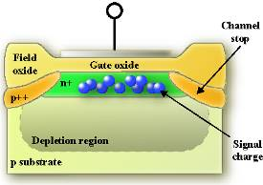
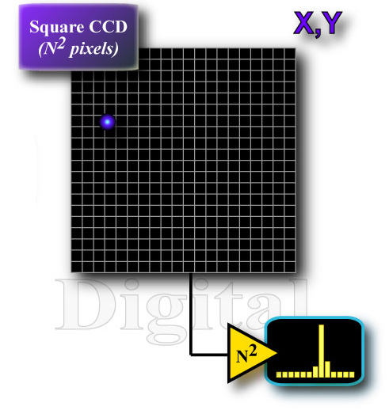
A basic system
Assume we have matrix pixels detectors. We want to use some of them to track particles passing through a so called “telescope”
x, y
512×512 pixels
4 planes
10 reading per second
14 bits resolution
USB 2.0 40MByte/s
Ethernet 10 MByte/s
RS232 12KByte/s
…
512²×4×10×14 ≈ 147 Mbit/s ≈ 18.3 Mbyte/s
10⁴ readings → ≈ 20 Gbyte of data…

Slide 12
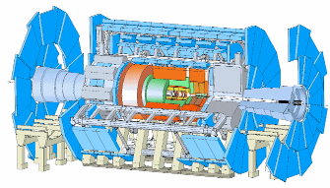
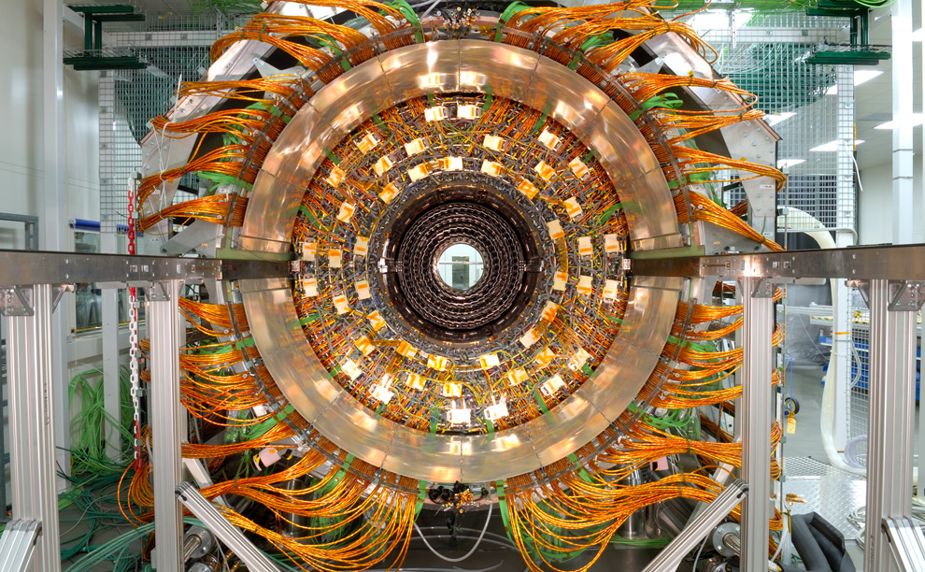
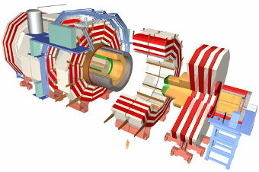
Megalithic systems
And, of course, there are far bigger problems of DAQ when the experiment comes big!
16000 pixel chips
≈ 1×10⁸ pixels to read
100 KHz trigger
8 bit resolution
80 Tbit/s ≈ 10 Tbyte/s

Slide 13
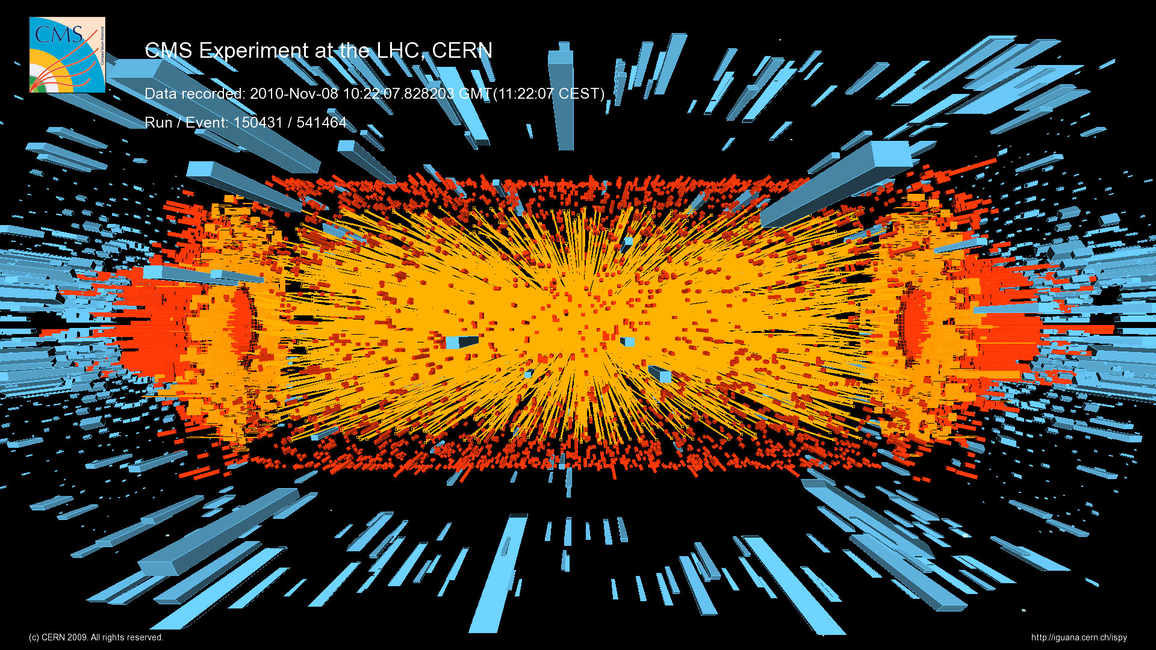
Megalithic data flow

Slide 14
Sparsification - 1
Among the many ways to approach the problem, the obvious one is to transmit only the useful part of the information, in this case only the pixels struck by a particle
Among all pixels, just a few carry any useful information…
We would like to transmit only the interesting part of the data, in principle the X and Y position of the particle.
Send only the pixels we need to calculate the particle position, and then elaborate this data on a computer.
Find a solution to get the X and Y position and then send only this information.

Slide 15
Sparsification - 2
First way: put a threshold level and send the coordinates of all the pixels with value higher than the threshold.
(P_{1x}, P_{1y}, P_{1v})
(P_{2x}, P_{2y}, P_{2v})
…
(P_{nx}, P_{ny}, P_{nv})
Drawback: if I keep the threshold low to avoid losing low signals, I will get a lot of simply noisy pixels.
For each pixel over threshold we have to transmit both value and position, so for a 512² pixels detector we need:
9 bits X position
9 bits Y position
14 bits pixel value
32 bits each transmitted pixel
So, to make the solution convenient, I need the threshold high enough to discard 75% of the pixels. This could be a pretty thigh limitation. Moreover, to get a real improvement in data reduction (a factor 10 at least), the threshold should discard 97% of the pixels at least.
Difficult due to noise!

Slide 16

Sparsification - 3
A good way is to try recognizing the shape of a cluster we know to be the “firm” of a particle passing through. After the cluster recognition, we could in principle pass just the cluster position and, if needed, for example, the weight.
Cluster recognition is not so complicate: assuming we are searching for n² sized clusters, a simple yet effective approach could be:
1
Central pixel of the cluster higher than a given threshold
2
Global S/N ratio of the cluster over a given level
3
Central pixel level over rest of the cluster sum ratio bigger than a so colled “shape parameter”
Being able to perform an accurate position calculation (center of mass of the cluster), I could just transmit the position of the passing particle, so maximizing the efficiency of the DAQ system. It is obviously not possible to further reduce the amount of information to transmit!

Slide 17

Sparsification - 4
The question is: how to perform cluster analysis fast enough to cope the pace of the chip readout? And how to do this when you have thousand chips to read? Consider that for our usual example system (512² pixels, 10 frames/s) and a cluster to search for of 3×3 pixels, we should be able to perform the following calculation some millions times per second!
Cluster recognition
Position calculation
1
We need some extremely fast, parallel computing power
2
b
+
a
3
Even the most powerful desktop available is by far too slow only to start thinking about doing something similar! Remember than MIPS are elementary operation per second!

Slide 18
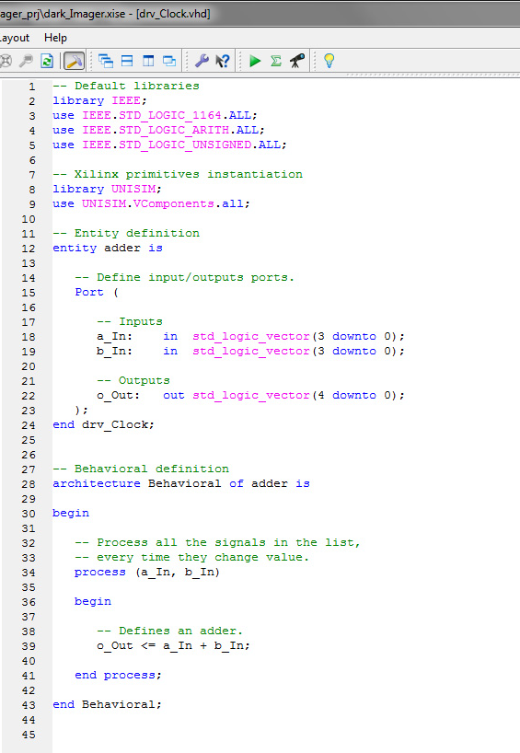
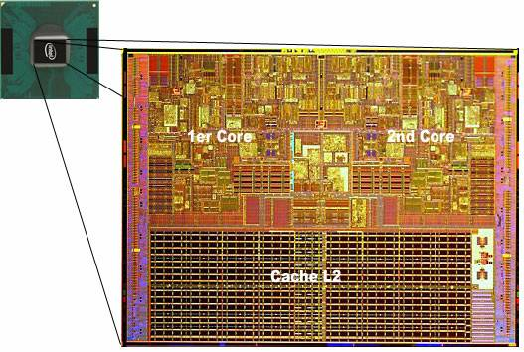
in processors
+
a
b
1) Point register with a
2) Take a from register
3) Address a to the ALU
4) Point register with b
5) Take b from register
6) Address b to the ALU
7)Take c from ALU
8) Set c into stack
9)Pop the stack
...
n) ...
Many clock cycles
a
b
o
o
a
b

Slide 19
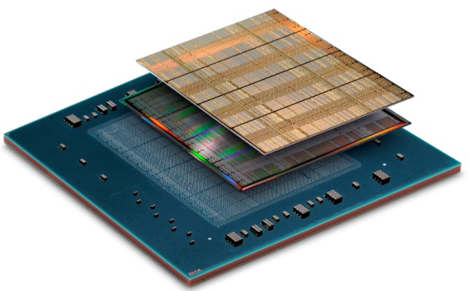
in FPGAs - 1
+
a
b
An answer: programming a circuit (NOT a processor) to perform the operations we need on the data flow. A programmable circuit is nowadays available in the form of a Field Programmable Gate Array, FPGA.
An FPGA parses input data and provides output data, just like a processor, but without running a program! The program is actually “hardwired” into the FPGA itself: this drastically improves speed, at the cost of flexibility.

Slide 20
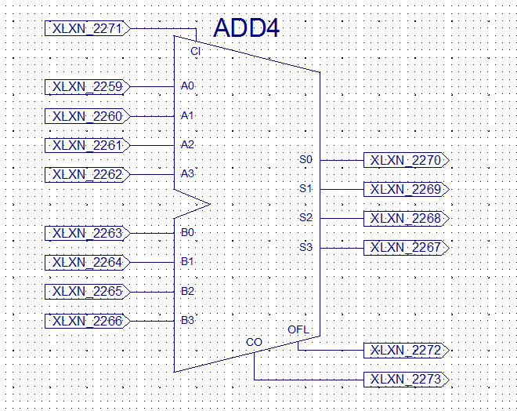
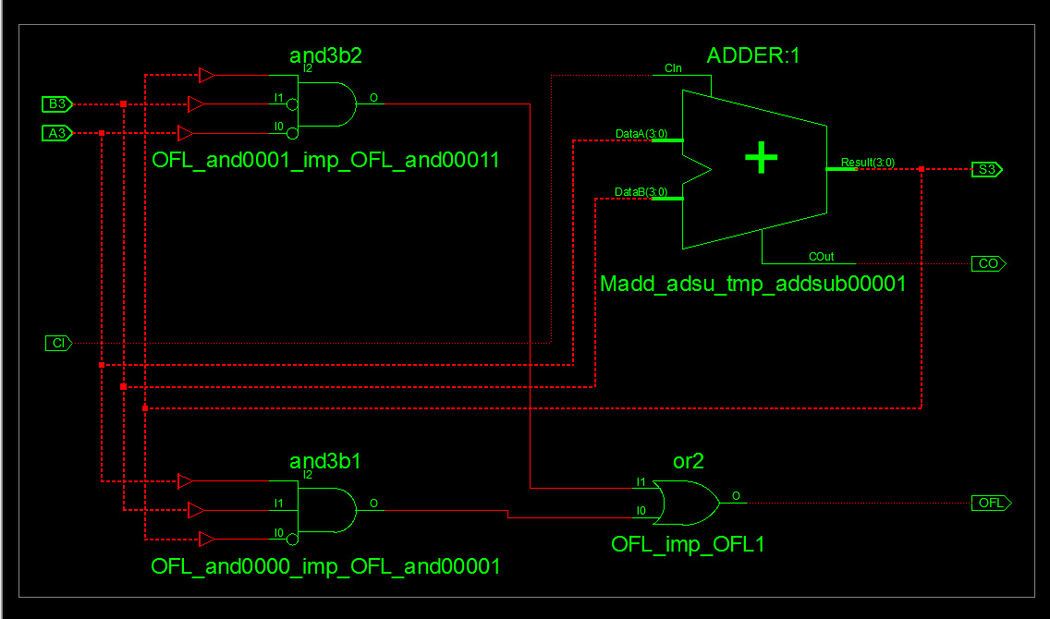
in FPGAs - 2
+
a
b
a
b
o
o
a
b

Slide 21
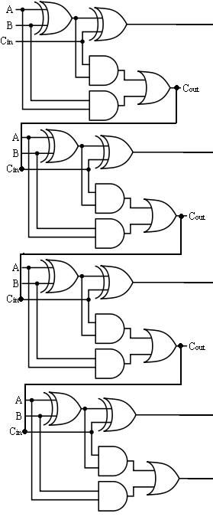
in FPGAs - 3
+
a
b
1 (or less) clock cycle!
a₀
o₀
b₀
= +
o
a
b
a₁
o₁
b₁
a₀
b₀
a₁
b₁
a₂
a₂
b₂
o₂
b₂
a₃
b₃
a₃
o₃
b₃
Operands being
processed
o₄
Result

Slide 22
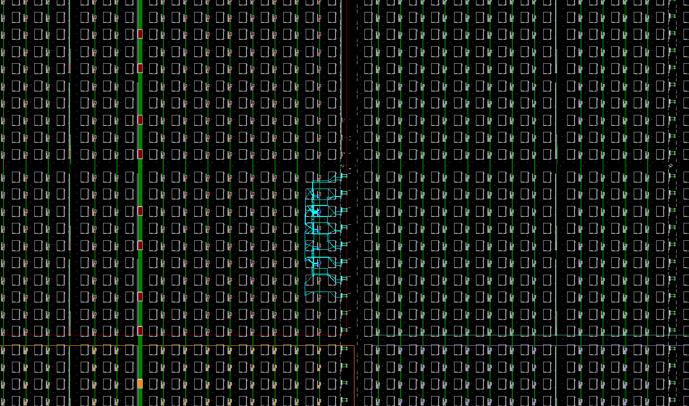
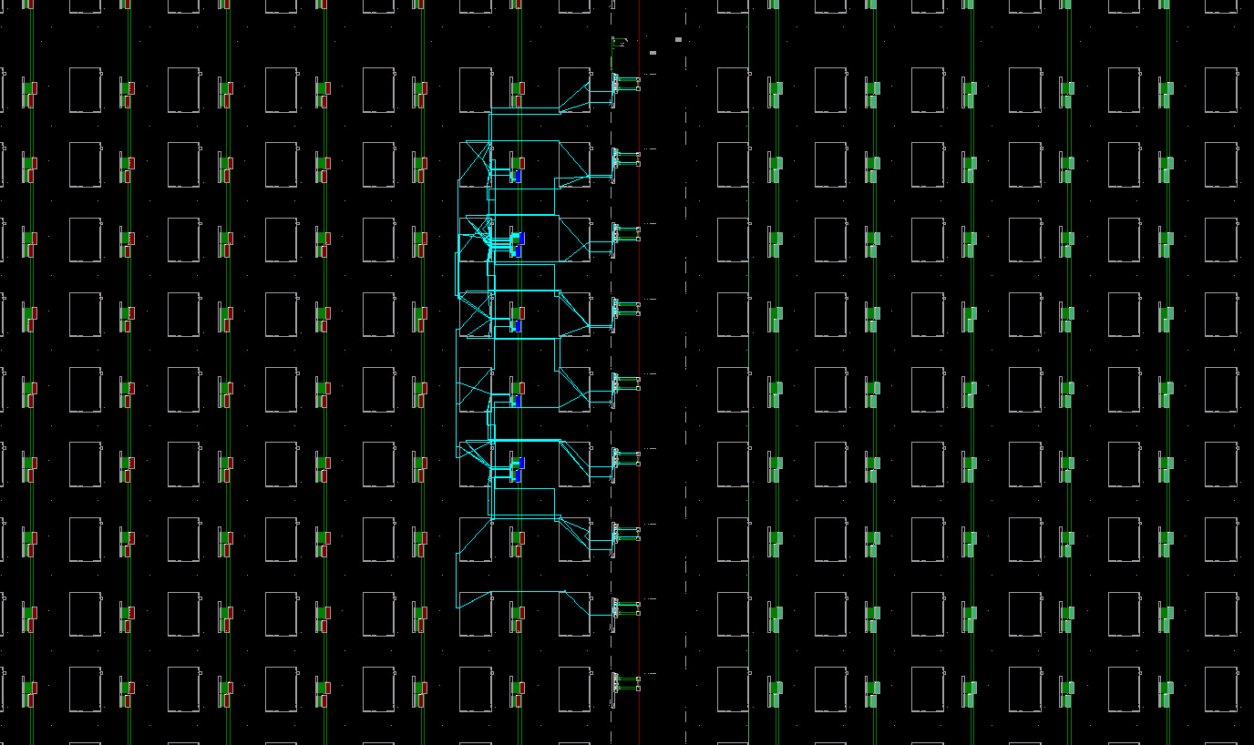
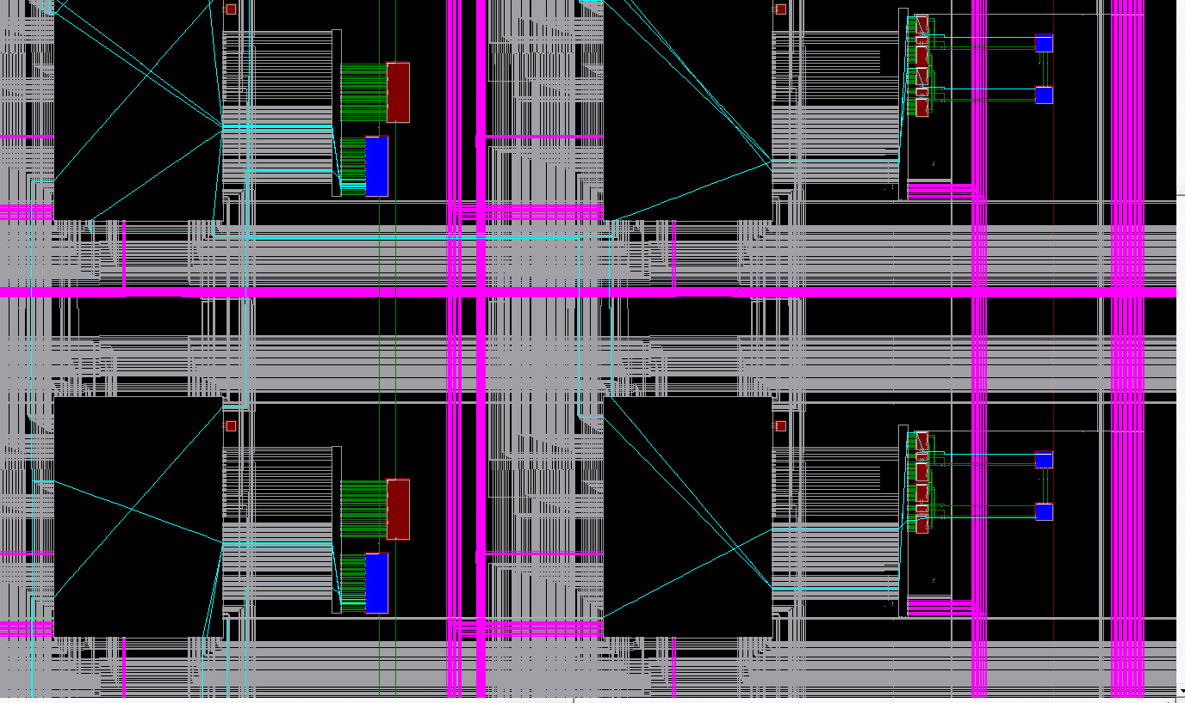
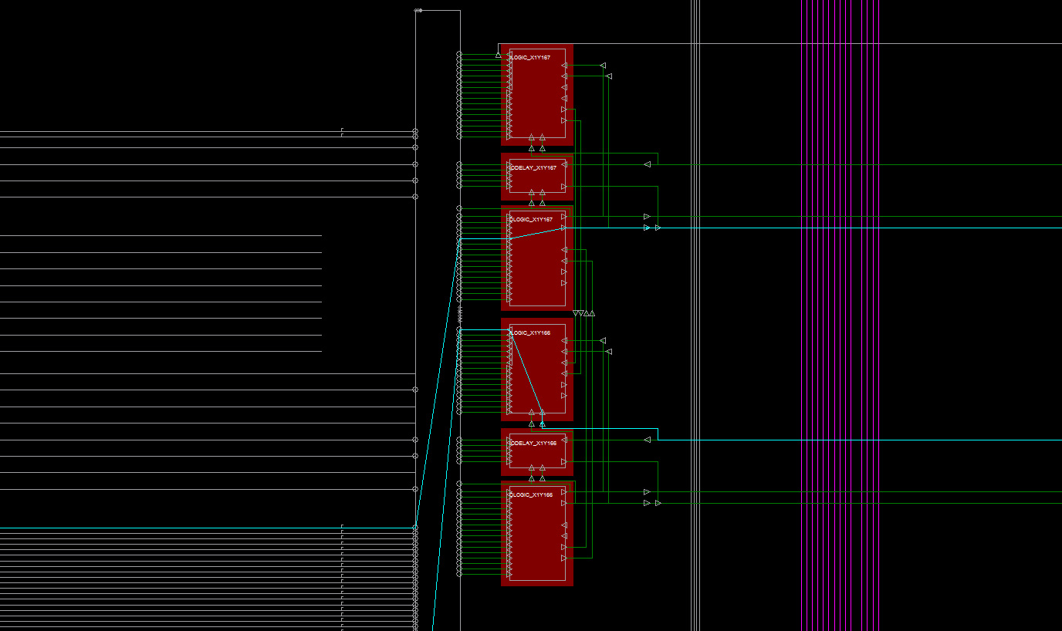
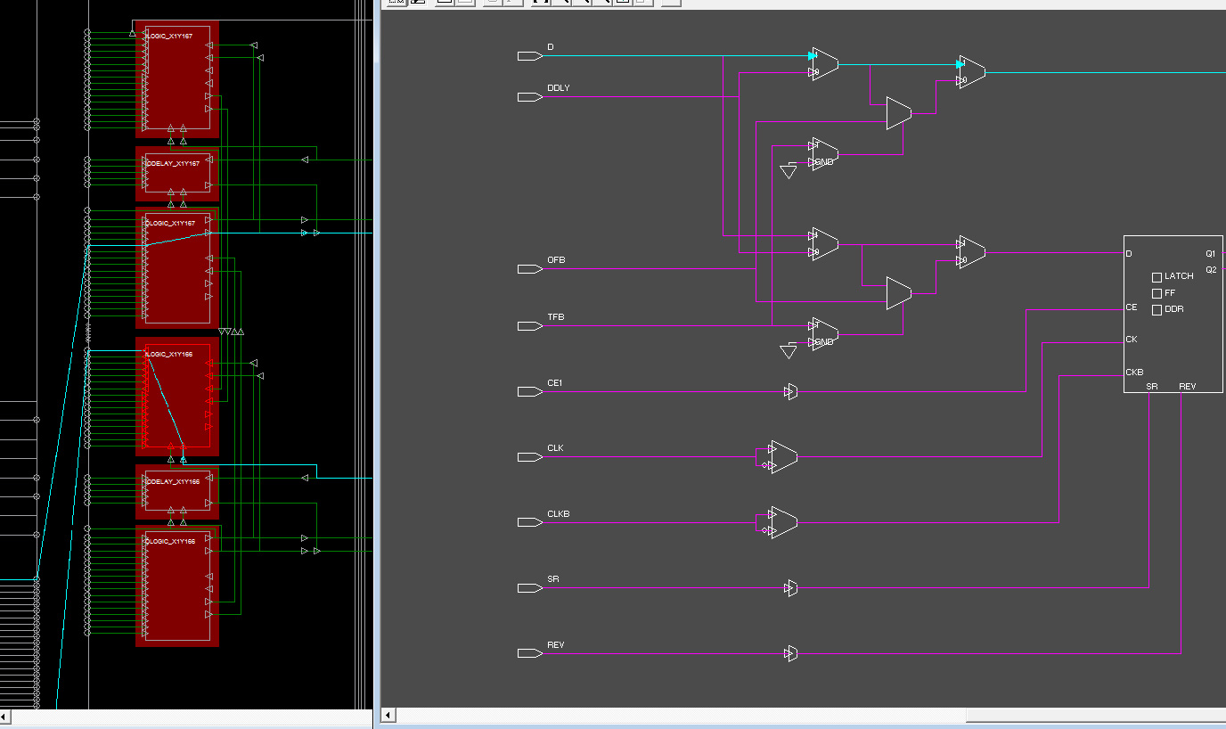
in FPGAs - 4
+
a
b

Slide 23
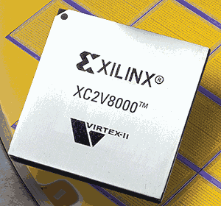
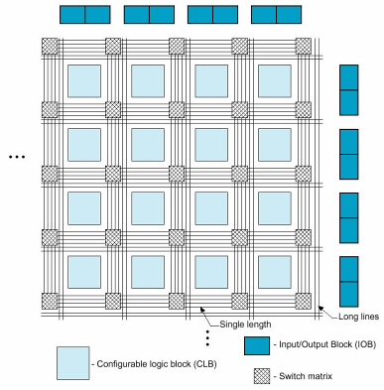
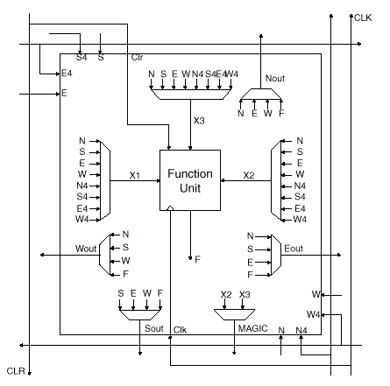
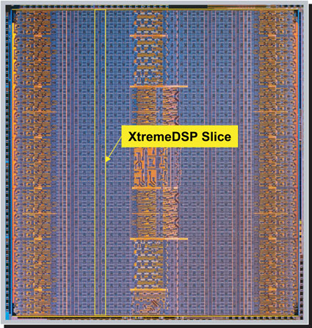
in FPGAs - 5
+
a
b
One could (in principle) design the circuit he needs to address a specific problem (ASIC, Application Specific Integrated Circuit). This is extremely expensive, and feasible only when a huge production request can justify the development budget. A recent and more flexible approach is offered by the Field Programmable Gate Array (FPGA).
FPGA
An FPGA can be thinked as a collection of identical elementary cells containing some basic circuits (usually one LUT, a couple of D flip
flop and a shift register) which can be differently interconnected by simply programming the device, allowing to build up complex circuits without the necessity of tailored production.

Slide 24
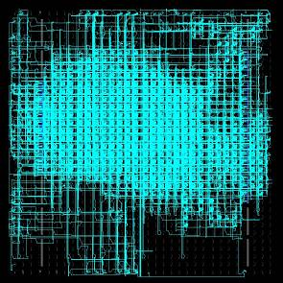
in FPGAs - 6
+
a
b
1
2
3
Through a programming language (VHDL, Verilog) is possible to describe the behavior of digital circuits in terms of usual programming constructs (loops, cases, if then else…).
Once the program is completed, it is translated into the equivalent electric circuit and, once verified, a connection map is generated (implementation).
The connection maps tells to the FPGA how to connect the elementary cell in order to get the designed circuit. Once downloaded to the chip, the FPGA behavior will exactly match the written code
o = a + b
Synthesis
Implementation
Programming

Slide 25
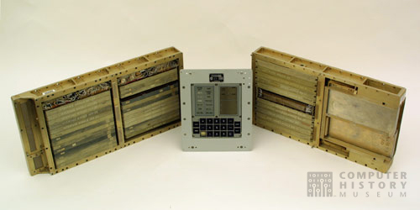

A complete system
Embedded processor usually manages communications and other general system functions.
Signal condition should be tuned to give the optimum S/N ratio.
S/N Ratio sets the ADC resolution while shaping time sets its sampling rate.
int main(int argc,char*argv[])
{
For (n=0;n<a;n++) {
...
}
}
Detector
ADC
A good DAQ system should deliver the smaller possible data load to the data analysis/storage system!
event clock (a,b,d)
c<=a+b;
f<=a+d;
g<=a+c;
end;
The ADC can be implemented inside the detector.
FPGA logic is used to perform low-level, high speed data reduction.

Slide 26
Embedded system - 1
A further step in DAQ system implementation is the use of one (or more) embedded processor. An embedded processor is a processor built inside an FPGA. The advantage of this approach is the possibility of ultra fast data throughput between the processor (where you can run something like c code) and the FPGA itself, as they are inside the same chip.
Combining the two coding levels (hard & soft) allows for a more efficient data manipulation and communication handling
int main(int argc,char*argv[])
{
For (n=0;n<a;n++) {
...
}
}
event clock (a,b,d)
c<=a+b;
f<=a+d;
g<=a+c;
end;

Slide 27
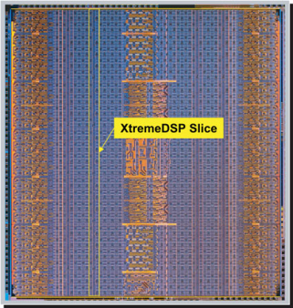
Embedded system - 2
Just to increase confusion, there are two different type of embedded processor: soft processor and hard processor.
A real processor can be integrated into the FPGA at chip design time. It is usually a RISC processor and the FPGA logic is used to interface it.
Fast, powerful
Expensive, not flexible as a “soft” processor
A
event clock (a,b,d)
c<=a+b;
f<=a+d;
g<=a+c;
end;
As hard coding describe circuits, you can “describe” an entire processor with it. This is what don with “soft” processor, which are implemented inside an FPGA by using the FPGA logic cells.
Flexible, easy to adapt to any need.
Use FPGA resources and is slower than an “hard” processor
B

Slide 28
Hardware synthesis
So, if at the end we still have to write code, where is the difference respect to usual processing? The BIG difference is that the hardware-level code is a description of a circuit, not a series of instruction for a processor.
event clock_raise(a,b,d)
c<=a+b;
f<=a+c;
g<=a+d;
end;
Hardware programming is extremely low-level!
Just bits to deal with
No subs, pointer, casting, ..
No loops, recursion, iteration
No matrixes/variables, data types
Even no division! (you need IP)
Terrible debugging (no printf!!)
Timing constrain to consider!
The three operation will be executed at the same time!
clock
a
+
c
c
b
c
?
The result of (a+b), c, will arrive to the input gate of the (a+c) adder after the clock pulse, and so the result will be wrong.
Non-sequentially and lack of high level features makes hardware-level coding pretty difficult.
But this become a strong advantage when we need speed and computation capacity!
+
f
+
g
g
d

Slide 29
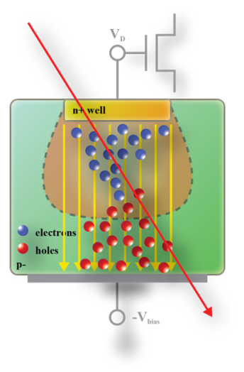
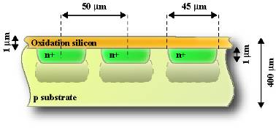
ADC resolution - 2
Let see an example: the minimum number of bits necessary to read the output of a pixel detector (CMOS) with given noise parameters.
Random noise
3000 e⁻
Charge signal
2000 e⁻
Leakage noise
1000 e⁻
Pattern noise
1 mip charge over 5*5 pixels cluster
the SIGNAL range is ≈ 3800 e⁻
We can see that: the RANDOM noise is ≈ 50 e⁻ the FIXED noise is ≈ 3200 e⁻

Slide 30
ADC resolution - 3
This example highlight another key point: an experimental system, especially on large scale, should be designed in order to maximize information efficiency!
Random noise
Charge signal
Only random (Gaussian, white) noise is considered to determine the necessary number of bits
Leakage noise
Pattern noise
1 mip charge over 5*5 pixels cluster
The effective resolution we have on the charge signal is very poor!
Note how 75% of system capacity is used to store un-useful information (fixed noise)! This is a typical indication that the whole system has to be improved!

Slide 31
FPGAs - 3
Processors are “slow” because they are general-purpose devices, and they have to interpret a code to perform a task. Off course this is their bigger advantage: they are flexible. The result is that you can use a computer to do near everything.
But it is also possible to implement an hardware description of the operation, directly using basic logic elements
o = a + b
1) Point register with a
2) Take a from register
3) Address a to the ALU
4) Point register with b
5) Take b from register
6) Address b to the ALU
7)Take c from ALU
8) Set c into stack
9)Pop the stack
...
n) ...
The drawback is that this circuit can just perform a + b. But it takes 1 clock cycle to do it!
Many clock cycles

Slide 32
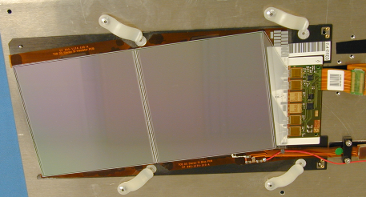
Scaling-up things
After the ADC conversion, we have to deal with numbers or, better, with binary numbers. This gives us huge capabilities in data manipulation we can perform with our DAQ system. In principle, we are set. Our data are now represented in a quantitative way we can interpret with a computer over our bench.
Is this the end of the story?
Let think if this could ever be the end of the story!
High Energy Physics (HEP) strip detector: ≈ 40000 channels in a silicon tracker

Slide 33
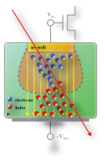
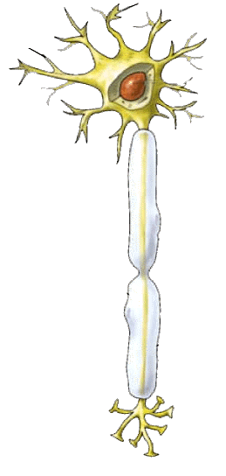

Getting complicate
Now look at this different case. Once characterized, we want to use our detector to count the particles passing through a defined area with just raw spatial resolution. The obvious idea is to place an array of such detectors.
So, we don’t need all the information carried by the graph registered by the fast digital scope. We need only to know which detector has been struck and, maybe, how many energy has been released inside it.
A
S
A
S
A
S
A
S
In this new case, a couple of number will be sufficient: detector ID and released energy. This “data reduction” is performed by the DAQ system.
DAQ
A
S

Slide 34
Information - data
Over the years, some common terminology has been established to refer to different data types. Correct data type selection can save huge amount of transmission/computational resources!
Unsigned byte [0 ÷ 255]
Unsigned integer [0 ÷ 2¹⁶-1]
Integer [-2¹⁵ ÷ 2¹⁵-1]
Unsigned long [0 ÷ 2³²-1]
Long [-2³¹ ÷ 2³¹-1]
This is the reason because we need the compiler being able to perform casting!
Single [-3.402823×10³⁸ ÷ -1.401298×10⁻⁴⁵ < 0 and 1.401298×10⁻⁴⁵ ÷ 3.402823×10³⁸ >0]
Whatever else you want/need…
This COULD seem obvious or not important, but it becomes extremely important in the case of hardware level or high speed computing! Mind this when you want perform real time data analysis/acquisition!

Slide 35
Information - how
The amount of information we need to describe a message is directly linked to its entropy (H(M)), i.e. to its level of indetermination. By the contrary, a message known “a priori” (H(M) = 0) does not need any information to be transmitted: we already know it!
Assume we want to represent all the possible results given by the sum of the throw of two dice. We know that we have 6×6 = 36 possible combinations, but we also know that only 11 are the possible final results of the sum.
+
1 2 3 4 5 6 1 2 3 4 5 6 1 2 3 4 5 6 1 2 3 4 5 6 1 2 3 4 5 6 1 2 3 4 5 6
1 1 1 1 1 1 2 2 2 2 2 2 3 3 3 3 3 3 4 4 4 4 4 4 5 5 5 5 5 5 6 6 6 6 6 6
2 3 4 5 6 7 3 4 5 6 7 8 4 5 6 7 8 9 5 6 7 8 9 A 6 7 8 9 AB 7 8 9 ABC
Thus we can agree on just 11 different possible messages to communicate the result of the throw. This is made possible because of not all possible results have the same probability to came.
Message
2 3 4 5 6 7 8 9 A B C
1 2 3 4 5 6 5 4 3 2 1
Frequency

Slide 36
Information entropy
A formal description of what sketched before is given by the information entropy theorem. Assume we have to receive a message M. Even if we don’t know “a priori” what the message will tell us, anyway we could guess about the most probable meanings of the message. The degree of uncertainty we have about the content of a message is equal to its information entropy.
Entropy of M
M is the set of all possible m messages that M could be
p(m) is the probability distribution of m in M
H(M) is maximized when all possible message contents m have equal probability to appear. In this case, the content of the message is completely random.
+

Slide 37
Smart DAQ
Go back to our dice. Consider the dice sum is the physical event we are looking for. The sensors (our eyes in that case) give me much more information than what I need. A good DAQ system uses only the information that really matter!
Signal out of the sensor
+
1 2 3 4 5 6 … 1 2 3 4 5 6
1 1 1 1 1 1 … 6 6 6 6 6 6
2 3 4 5 6 7 … 7 8 9 ABC
I need 6 bits to represent 36 possible results
Pay attention! The neuron is NOT a brain. DAQ can handle information only operating on a priori parameter, so DOES NOT perform any real data analysis!
2 3 4 5 6 7 8 9 A B C
1 2 3 4 5 6 5 4 3 2 1
Useful information
This very trivial example shows how what could seem just euristic (use the smaller possible # of bits) is in fact supported by robust math theory. And math theory comes handy when you have to deal with systems more complicated than two dice!

Slide 38
ADC errors - 1
Quantization error: error due to the flooring made by the ADC
By loosing 1/2^{n} in dynamic range I can improves by a factor 2 the quantization error RMS

Slide 39
ADC errors - 2
Error due to the clock jitter must be kept under control to not spoil resolution
ΔV_{T}
Δt
bits | ΔT limit for various input frequency
 | 44 kHz | 192 kHz | 1 MHz | 10 MHz | 100 MHz
8 | 28.2 ns | 6.48 ns | 1.24 ns | 124 ps | 12.4 ps
12 | 1.76 ns | 405 ps | 77.7 ps | 7.77 ps | 777 fs
14 | 441 ps | 101 ps | 19.4 ps | 1.94 ps | 194 fs
16 | 110 ps | 25.3 ps | 4.86 ps | 486 fs | 48.6 fs
24 | 430 fs | 98.8 fs | 19.0 fs | 1.9 fs | 190 as

Slide 40
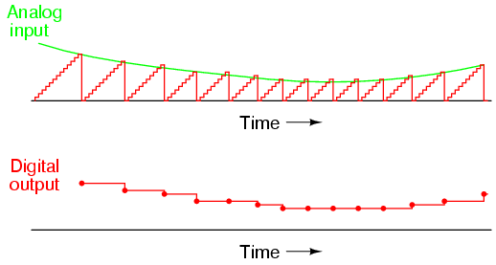
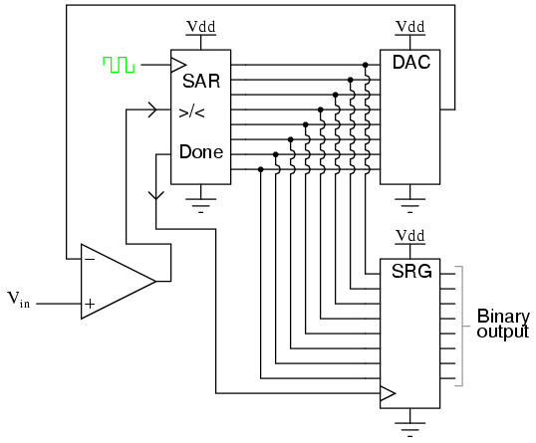
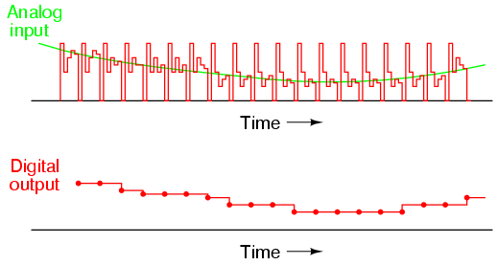
Approximation ADC
Successive approximation ADCs offer a higher resolution (up to 24 bits) at the price of a lower sampling rate. Many different implementation are possible.
Ramp ADC
Approximation ADC

Slide 41
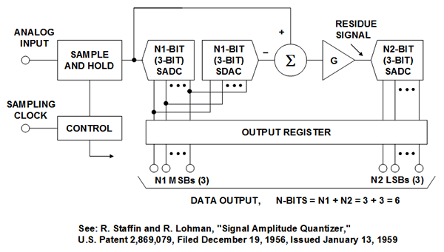
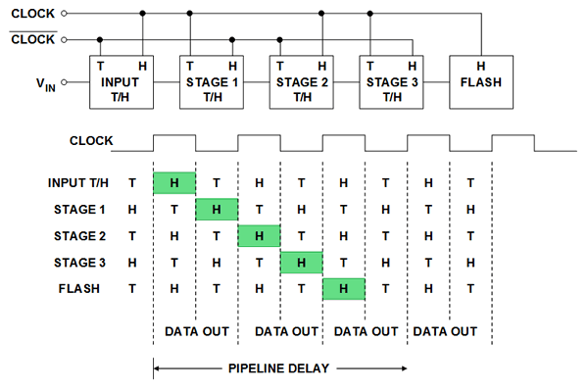
Pipelined ADC
The majority of nowadays medium to high speed ADCs (some to some 100 MSamples/s) uses the pipeline architecture. It is an excellent compromise between speed and resolution. For even faster sampling (GSamples/s) flash ADCs are at present the only way.
2 bit ADC
2 bit ADC
×4
2 bit ADC
×4
…
Data output of a pipeline ADC will be delayed by a number of clocks equal to the number of conversion steps.
10
00
11

Slide 42
ADC matching - 2
The noise of the analog signal to sample is the key factor together with the signal range in determining the resolution of the ADC.
Power
Amplitude
A_{noise}
A_{signal}
Note that the SNR for a given signal is defined over a specified BANDWIDTH
For an ADC the noise is considered equal to one LSB, so:
and hence the noise of an ADC in decibel results equal to:

