Slide 1
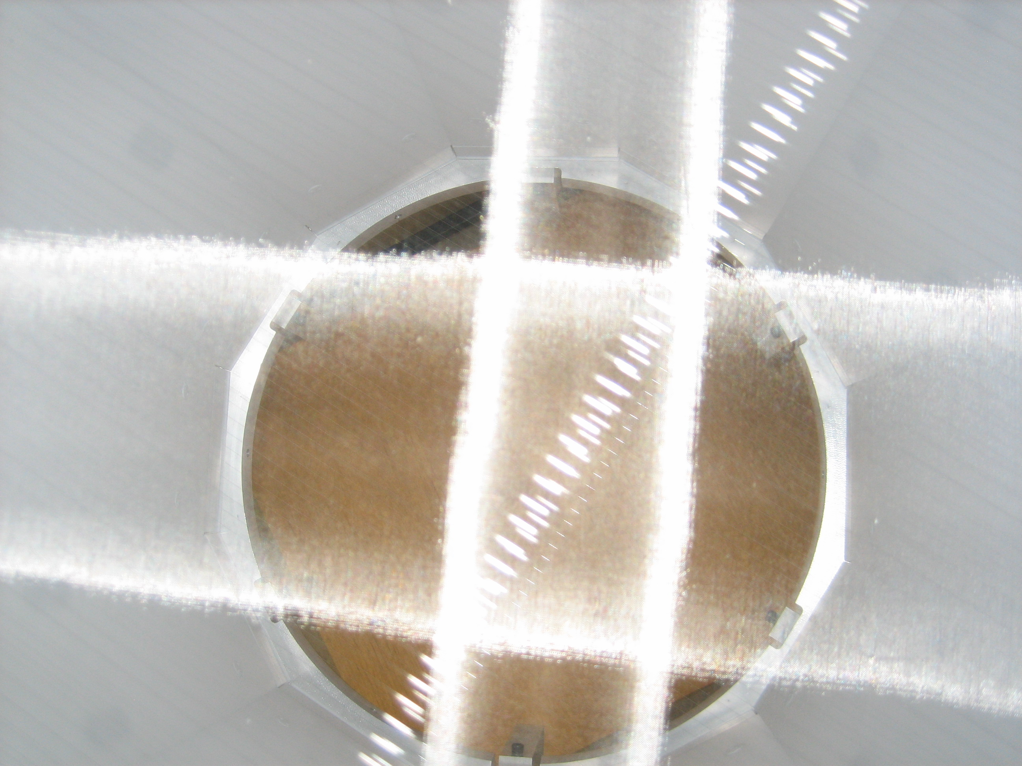
Basics of an
Electroluminescence
Time Projection Chamber
(EL TPC)
EDIT 2012
Fundamentals Group:
James White, Clement Sofka, Andrew Sonnenschien,
Lauren Hsu, Ben Loer, Chris Stoughton, Fritz Dejongh,
Hugh Lippincott, Jong Hee Yoo

Slide 2
LESSON
Concept of Electroluminescent Time Projection Chamber (EL TPC) – uniform drift field and parallel plate EL gap
Scintillation mechanism in noble gases
Electron drift and diffusion in gases
Electroluminescence: aka light gain / proportional scintillation
Estimate charge yield of alpha in argon gas
Estimate EL yield
Will study the concept using a toy: ”EL TPCito”

Slide 3
EL TPC Physics Detectors
ZEPLIN II/III two-phase xenon WIMP search
XENON 10/100 two-phase xenon WIMP search
LUX two-phase xenon WIMP search
WARP two-phase argon WIMP search
DarkSide two-phase argon WIMP search
PANDA-X two-phase xenon WIMP search
NEXT-100 high pressure xenon 0νββ search
many other prototypes for reactor monitoring, homeland defense, medical …

Slide 4
Concept
How does it work?
Gamma
(for example)
Light detectors
Anode
EL Gap
Electroluminescence (S2)
Gate
Electron drift
Interaction
and
Drift Region
E-field
Deposits energy
Flash of scintillation (S1)
Cathode
S1
S2
Time

Slide 5
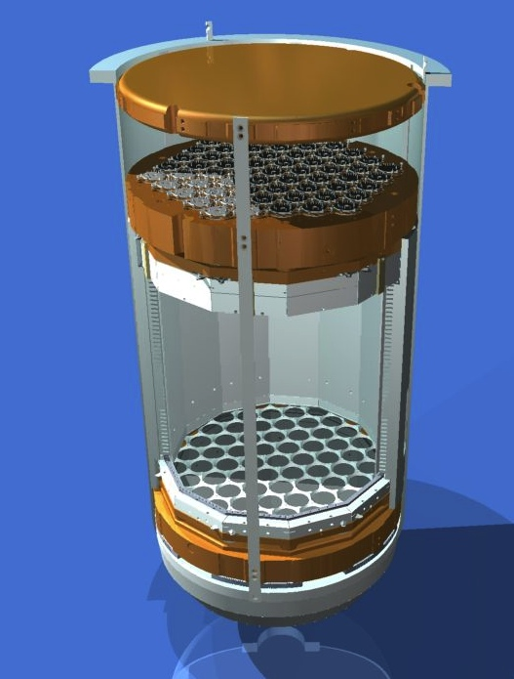
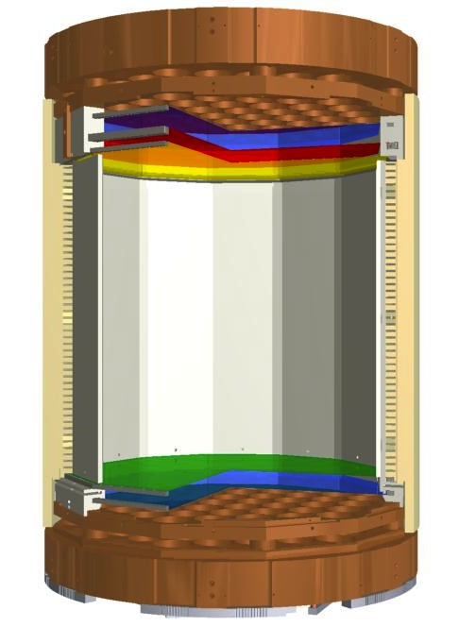
Example: LUX
50
cm
50
cm

Slide 6
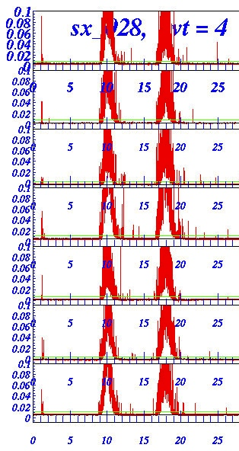
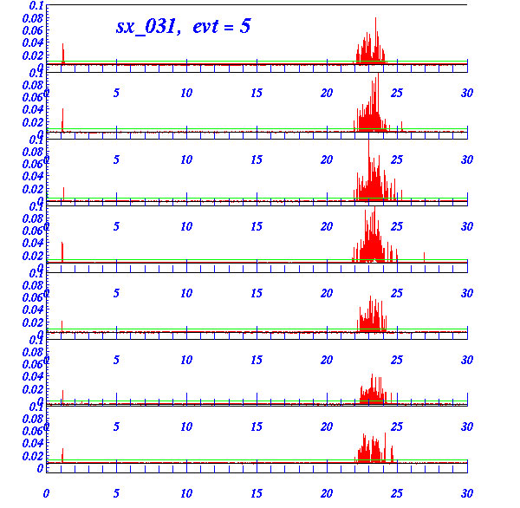
e.g. High Pressure Xenon TPC
Neutron
(or
WIMP)
60 keV Gamma
S1
S2
30 keV e-
30 keV
X-ray
30 keV e-

Slide 7
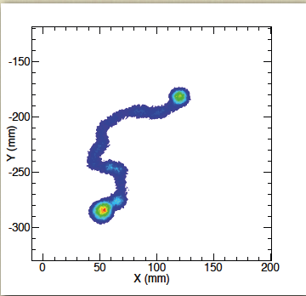
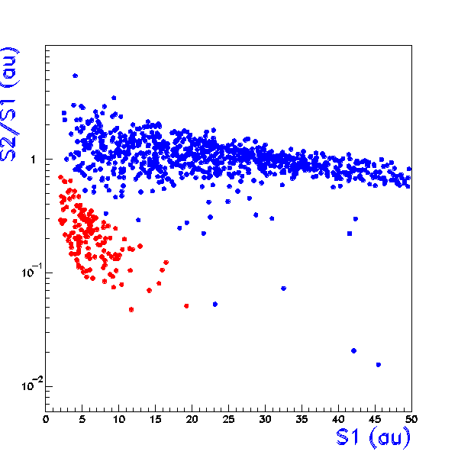
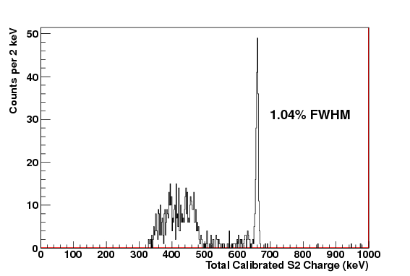
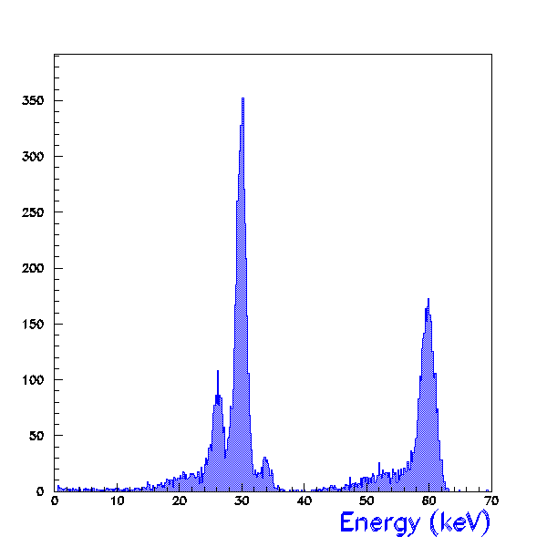
Why use an EL TPC?
NR discrimination
Tracking
electron recoils
nuclear recoils
²⁴¹Am
¹³⁷Cs
30 keV
Energy
Resolution
662 keV

Slide 8
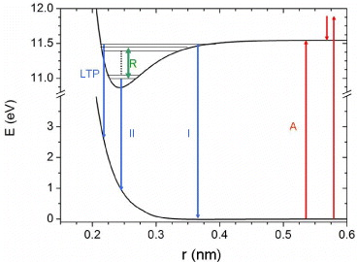
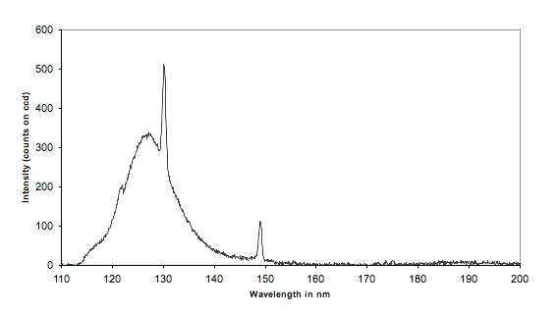
Scintillation Mechanism e.g.Argon ~1 bar
(Similar in other noble gases)
Atom excited by particle interaction:
Ar* + 2Ar → Ar₂* + Ar
Ar₂* → 2Ar + hν
And, recombination can produce light:
Ar⁺ + e⁻ → Ar*
128 nm

Slide 9
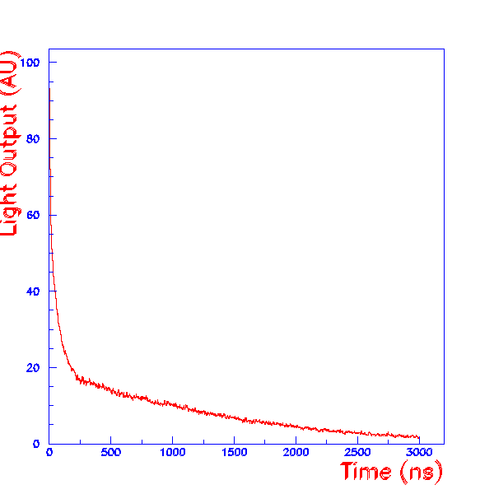
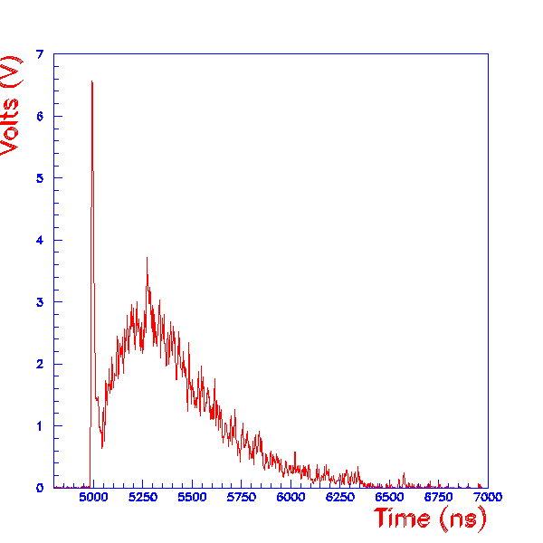
Argon Scintillation (cont)
Fast component (singlet)
Penning effect
Slow component
(triplet)
Example of alpha-induced scintillation (S1)
in pure argon at P ~ 50 bar with zero drift
field. (Summed pulses from a high pressure
test cell at TAMU.)
Similar, but single event with a trace of
xenon. Interaction with impurity atoms
greatly alters pulse shape.

Slide 10
Argon-N₂ Scintillation

Slide 11
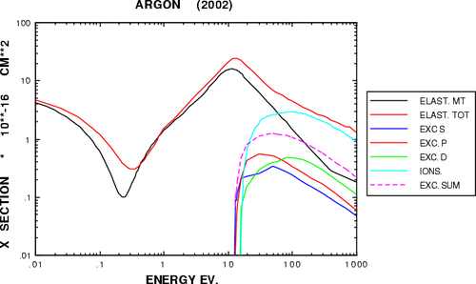
Electron Drift
With no electric field, liberated electrons will obtain a Boltzmann energy distribution E ~ kT - some will recombine with the positive ions.
With an electric field E present, electrons will drift with velocity v ~ µ E, where
µ is the electron mobility in the gas
(µ is a function of density, gas mixture etc.)
In presence of E, electrons “heat up” and average energy of collision increases.
The mean-free-path between collisions,
λ = 1/(σ n) where σ is the collision cross section and n is the number density of gas atoms.
http://garfield.web.cern.ch/garfield/help/garfield_41.html#Ref0347
elastic
ionization
excitation
Ramsauer
minimum
Cross section for electron collisions in argon

Slide 12
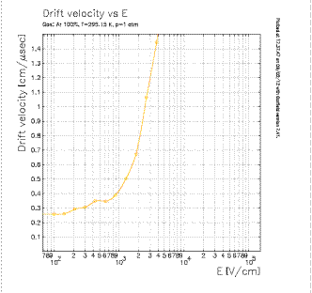
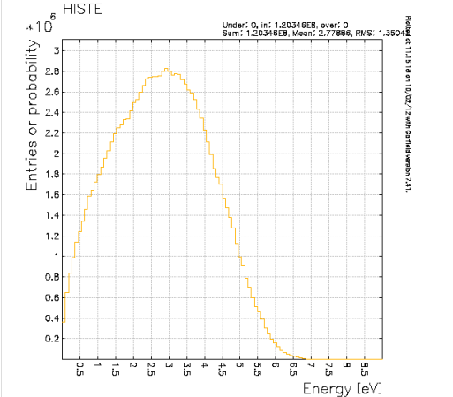
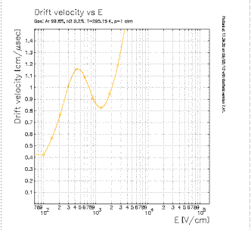
Electron Drift (cont)
Example:
σ ~ 4 E-16 cm² and n ~ 3 E19 /cm³
λ = 1/(4E-16 * 3E19) ~ 8E-5 cm ~ 800 nm
But
σ ~ 1 E-17 cm² and n ~ 3 E19 /cm³
λ = 1/(1E-17 * 3E19) ~ 3E-3 cm ~ 30 µm
note
Atomic spacing is ~ 1/(3E19)^{1/3} ~ 3E-7 cm ~ 3 nm
Ar 1 bar
Garfield/Magboltz output
Electron energy distribution in
pure argon, E_{drift} = 326 V/cm
ArN₂(0.2%) 1 bar

Slide 13
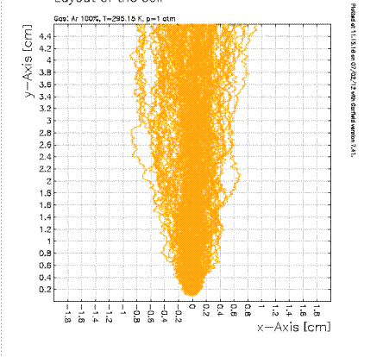
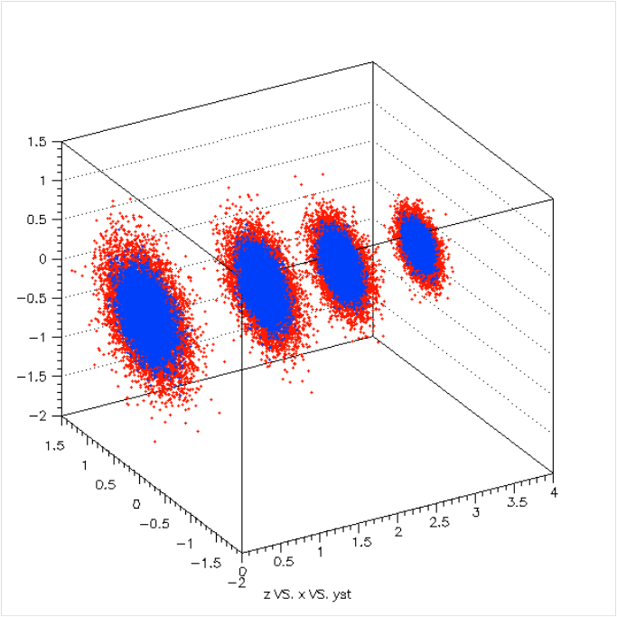
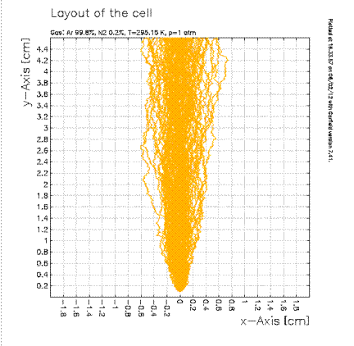
Electron Diffusion
4.5 cm
σ = (2Dt)^{1/2}
Pure Argon 1 bar, 326 V/cm
Argon 99.8% N₂ 0.2%

Slide 14
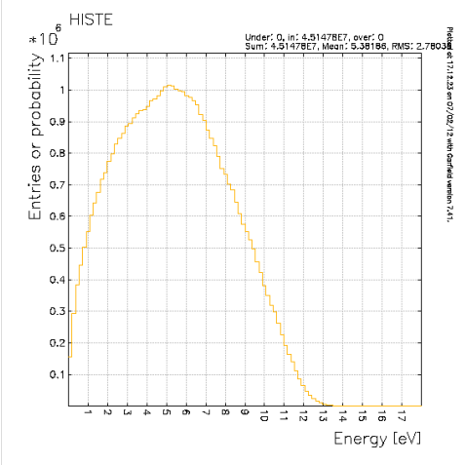
Electroluminescence
At some value of E, the energy of drifting
electrons can exceed energy needed to excite atoms
Note, these are above excitation threshold but below ionization
threshold.
Excitation
Threshold
11.6 ev
Ionization
Threshold
15.7 eV
This allows optimum energy resolution
because there are no fluctuations added
due to ionization process
Argon: 1 bar, 2133 V/cm

Slide 15
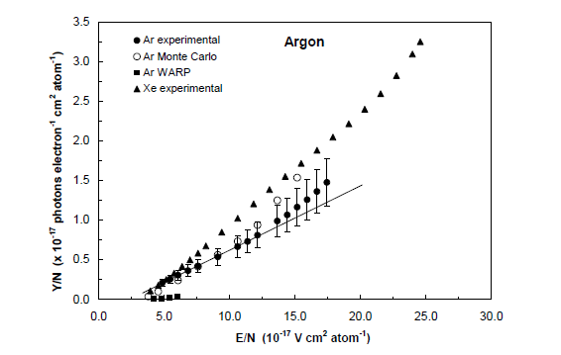
Electroluminescence
Yield in argon
Example: say
N ~ 3 E19 atoms/cc
E = 2100 V/cm
E/N = 7E-17 V cm² atom⁻¹
➔Y/N ~ 0.4E-17 ph cm² /e-/atom
So
Y = N*Y/N ~ 120 ph/e-/cm
http://hdl.handle.net/10316/1463
Thesis of C.M.B. Monteiro, U. Coimbra

Slide 16
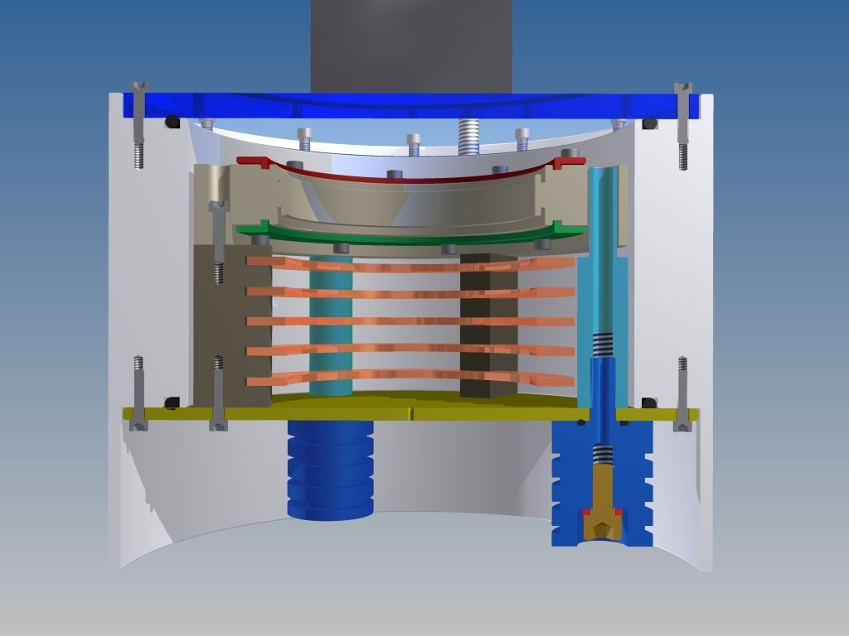
EL TPCito
PMT
TPB-coated window
1.5 cm
Anode grid
HD polyethylene vessel
4.6 cm
Gate grid
Field rings
Cathode
HV Feed-thrus

Slide 17
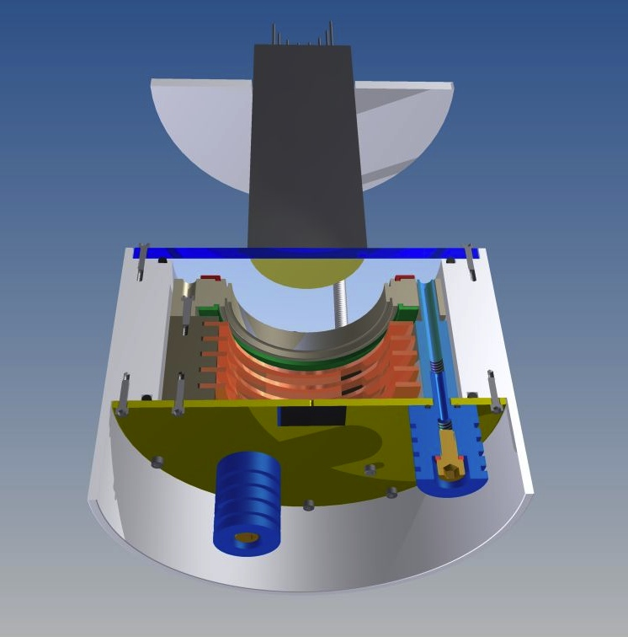
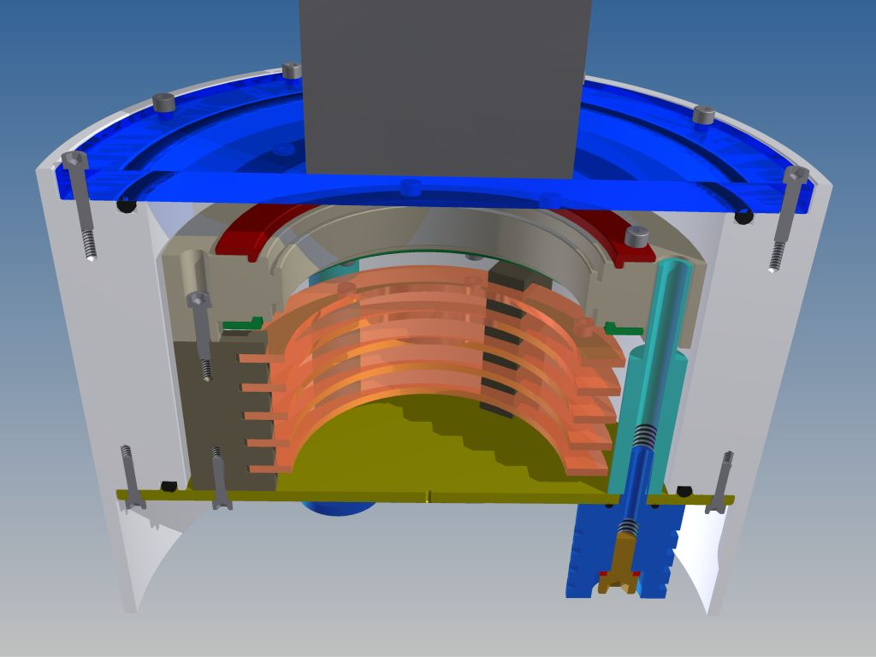
EL TPCito (cont)
source location

Slide 18
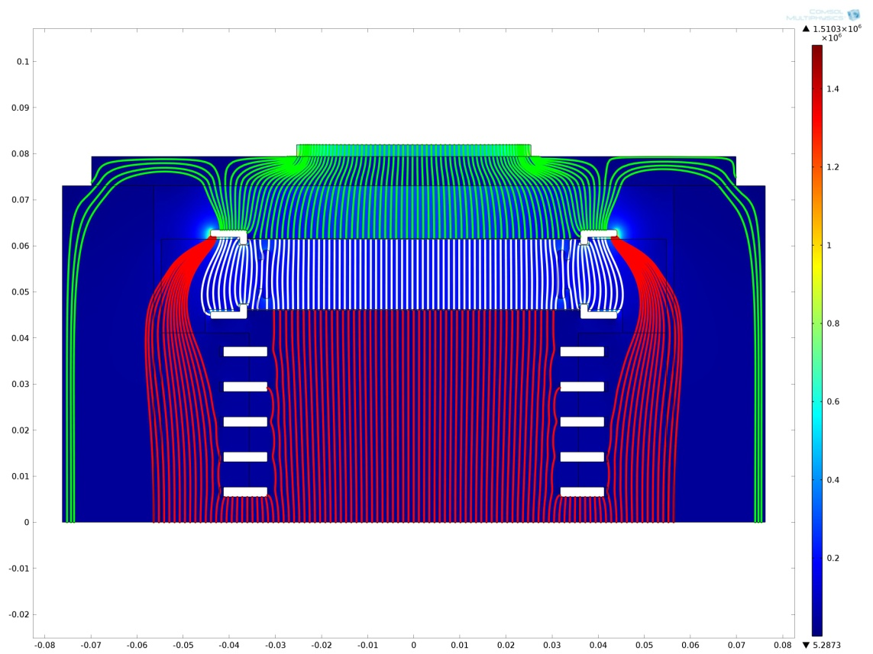
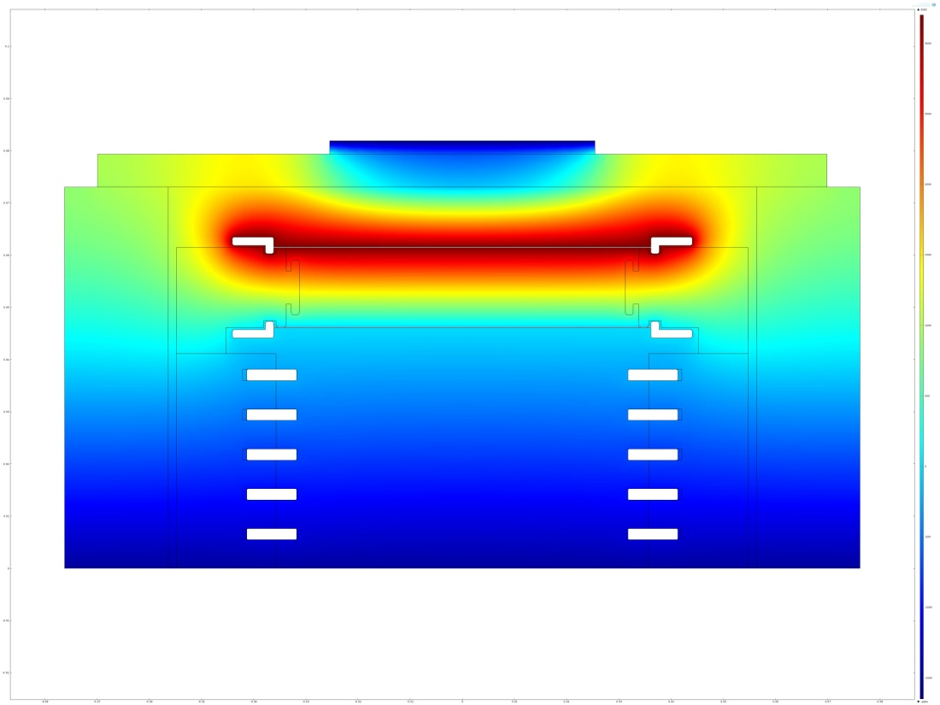
Electro-statics
Electric Field Lines
Electric Potential
EL gap
Drift region

Slide 19
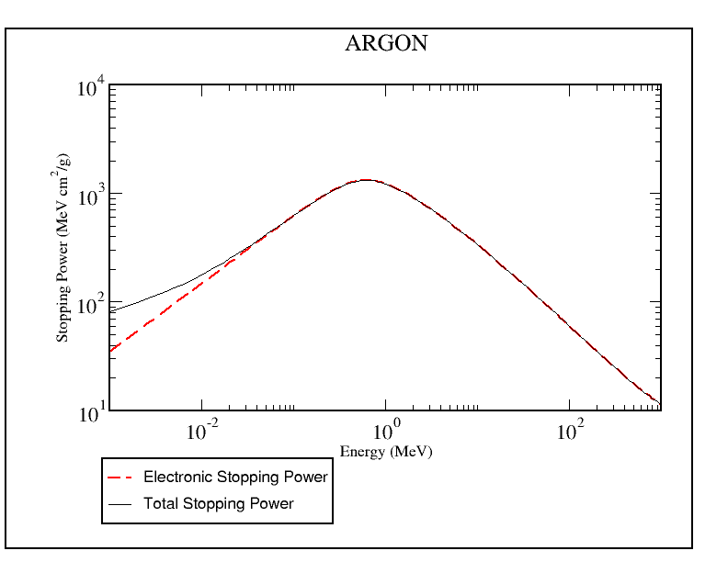
Alpha Signal estimate charge yield
²⁴¹Am Source E_alpha ~ 5.4 MeV
but,Am covered with 0.0002 cm Au
stopping power in Au ~ 220 MeV cm²/g
SO energy loss ~ 220 * 19g/cc*.0002 cm
looses about 0.8 MeV
E_Alpha → 5.4 -0.8 ~ 4.6 MeV
http://www.nist.gov/pml/data/star/index.cfm
Stopping power: alphas in argon
Assuming there is no further material
between the source and the drift region:
Argon: density =1.7E-03 g/cc
E_alpha ~ 4.6 MeV
Projected Range ~ 7.3E-3g/cm²
Distance ~ 7.3E-3/ 1.7E-3
~ 4.2 cm
W ~ 26.5 ev/ion
4.6E6 ev/26.5 ev/ion
~ 170 k ions/alpha
excluding distance from source to
drift region, est~ 150 k ions drifting

Slide 20
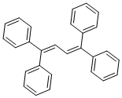
Alpha Signal estimate light yield
Light Yield?
N_ions ~ 150k/alpha
Y ~ 120 ph/e-/cm
x 1.5 cm EL gap = 180 ph/e-
Produce ~ N*Y
~ 2.7E7 128 nm γ’s into 4π
D
PMT
PMMA
d
TPB coating
EL Gap
But how many will we detect?
Back-of-envelope estimate:
PMT: D=5 cm ➔ A_{PMT} = π D²/4
d ~ 2.5 cm ➔ A_{sph}=4π d²
ΔΩ/Ω ~~ A_{PMT}/A_{sph} ~ D²/(16d²) ~ .25
TPB: 100% conversion, 50% go up, 50% down
QE of PMT ~ 0.2 in blue
Efficiency ~ ΔΩ/Ω *QE*.5(TPB effect)
~ .25*.2*.5 = 1/40 ~ 2.5%
So Detect ~ 2.7E7*.025 = 7E5 pe (photoelectrons)
First, need special window and
PMT to detect 128 nm directly
(e.g. MgF2 window and PMT)
So, use VUV to blue WLS (wavelength shifter)
Tetraphenyl - Butadiene (TPB)
Est 100% conversion efficiency

Slide 21
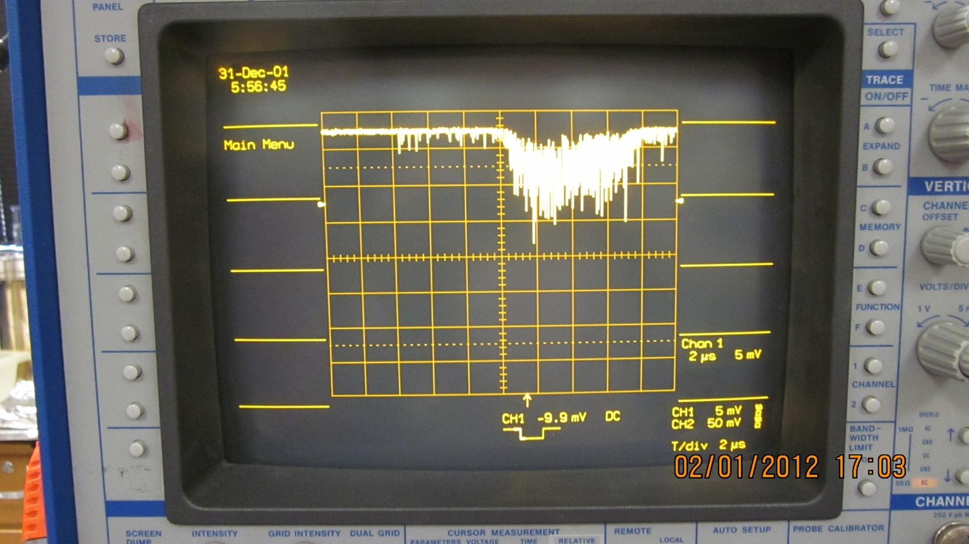
Example Signal
S1
Drift time
S2

Slide 22
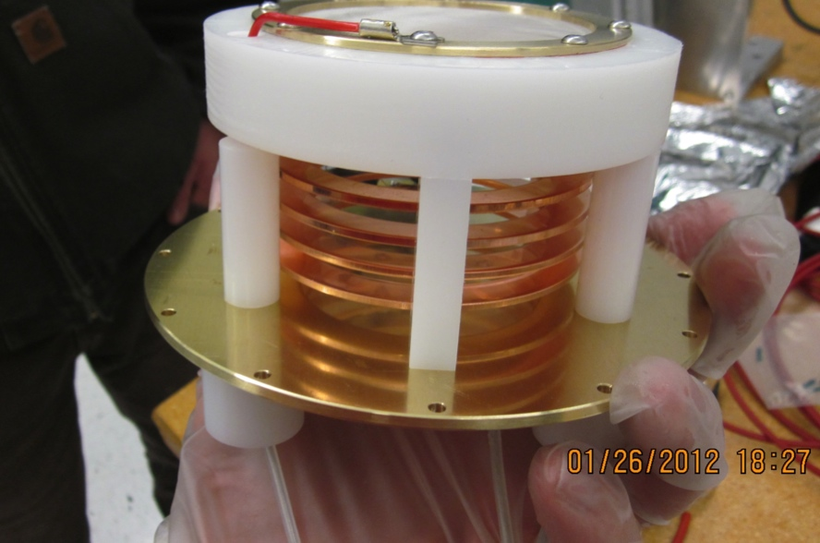
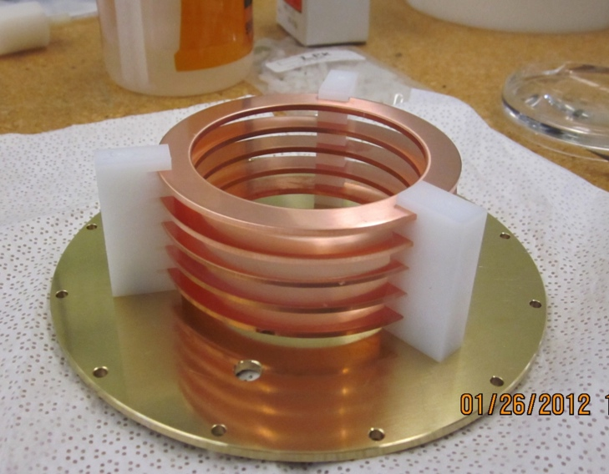
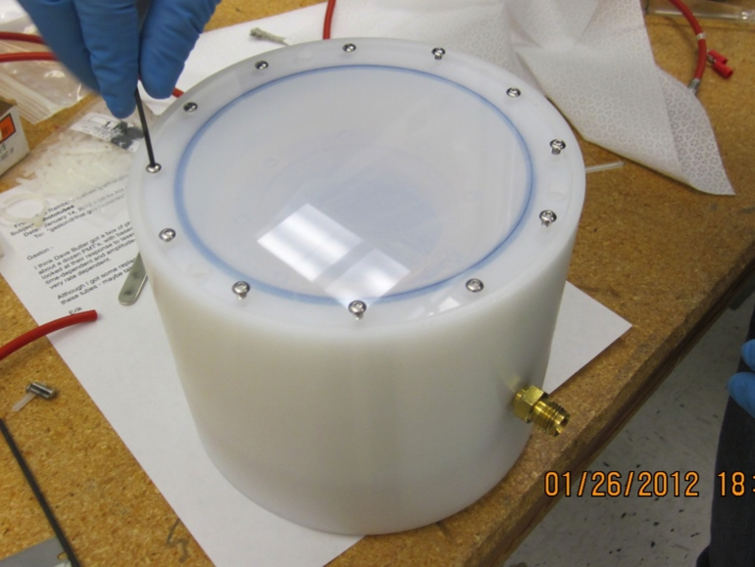
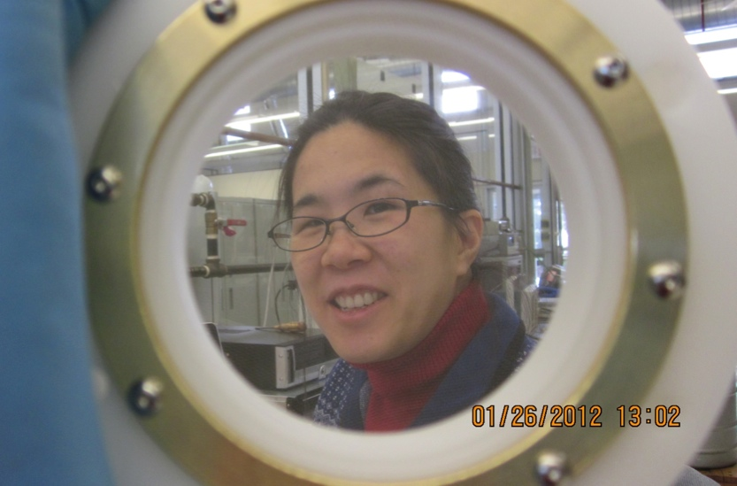
Construction
field rings on cathode
mesh placed on field rings
88% 0pen ss mesh anode and gate
hd polyethylene housing with
TPB-coated acrylic window

Slide 23
PLAN
View internals of toy detector
Assemble HV & signal cables, gas lines, and PMT in dark box
add alpha source and close dark box
turn on gas flow – first pure argon
Apply HV to PMT and observe single electron dark current on oscilloscope
bias cathode to -1500
bias gate grid to 0 V
raise anode voltage to ~ 3000 V and observe S1 & S2 signals
Is drift time from S1 to start of S2 what you expect?
vary drift field and EL field – observe changes
vary gas mixture – add ~ 0.2% N₂ – observe change in light yield, drift time
and pulse width – discuss
measure area of single electron pulse – this is tricky!
measure area of S2 pulse ➔ measure light yield – still tricky!
Is light yield reasonable considering back of envelope estimate?
Last, will try window without wavelength shifter –what will happen?

